Slide 1
Distributed energy system’s is the future of the world's power industry
Dr. of Sc. Prof. Mikhail Tyagunov
(National Research University “Moscow Power Engineering Institute”
Moscow, Russia)
Notes:
Currently a lot of talk about how it should look like the grid of the future. All the evidence suggests that it should be "smart", that is provided by means of measurements and information exchange. We think that it is not. In order to maintain system could be "smart", it must have a means of implementing "smart" solutions, and it depends on the structure of the power system and parameter settings in it.This issue is dedicated to my report.

Slide 2
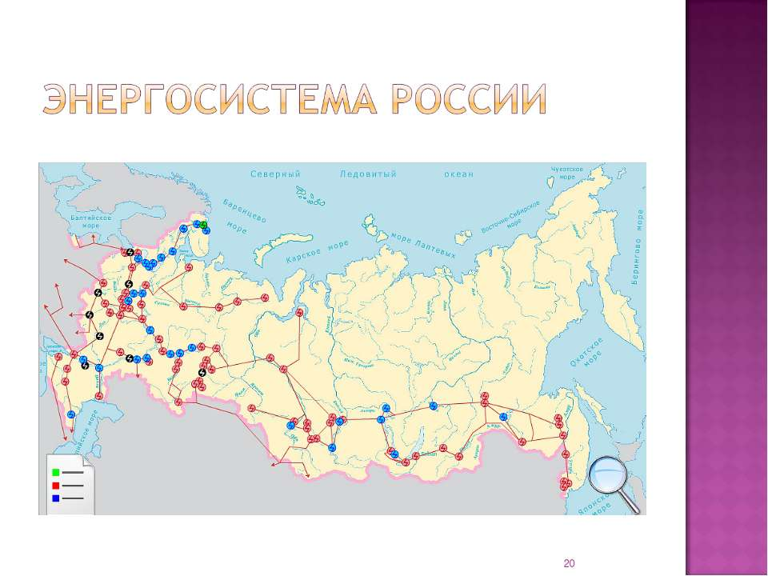
Power plant in the unified energy system
Concentration of large power plants in places close to energy sources increases their economy by reducing the cost of transportation or transferring fuel from the place of its extraction to the place of use.
Notes:
A vivid example of a centralized energy system is the energy system of Russia. It was constructed as a centrally managed system with one owner – the state.

Slide 3
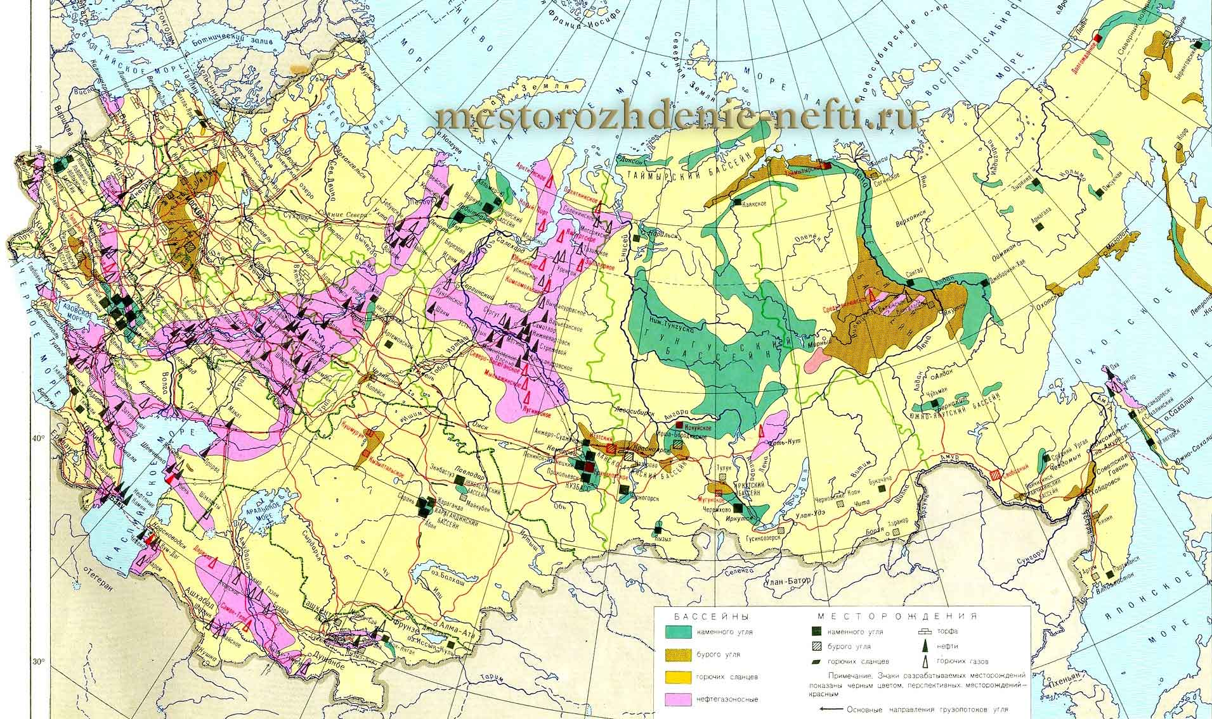
Distribution of fuel resources
The location of energy resources does not often coincide with the location of the main consumers of energy.
Notes:
The basis for the organization of power was the distribution of fuel resources, the distribution of consumers who need to connect generators with power grid. The main factor was the place where the extracted energy sources. Chief among them were hydrocarbons.

Slide 4
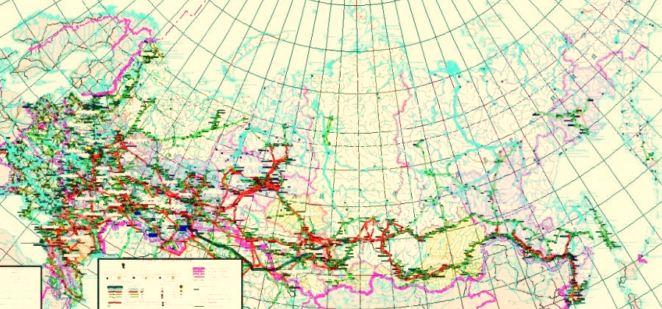
Electrical network
The location of the consumers of energy determines the scheme of electric networks.
Ensuring the survivability of a large electrical system - a complex of generators, networks and consumers - is achieved by dividing this large system into smaller components, and the part in which the emergency occurs is separated from the rest of the main system.
These parts becomes an independent Microsystems at the time of liquidation of the accident.
Notes:
Electrical network connected the main areas-consumers energy's main power plants of the country. It is seen that the electrical lines does not cover all territory of Russia, as is done in other countries.

Slide 5
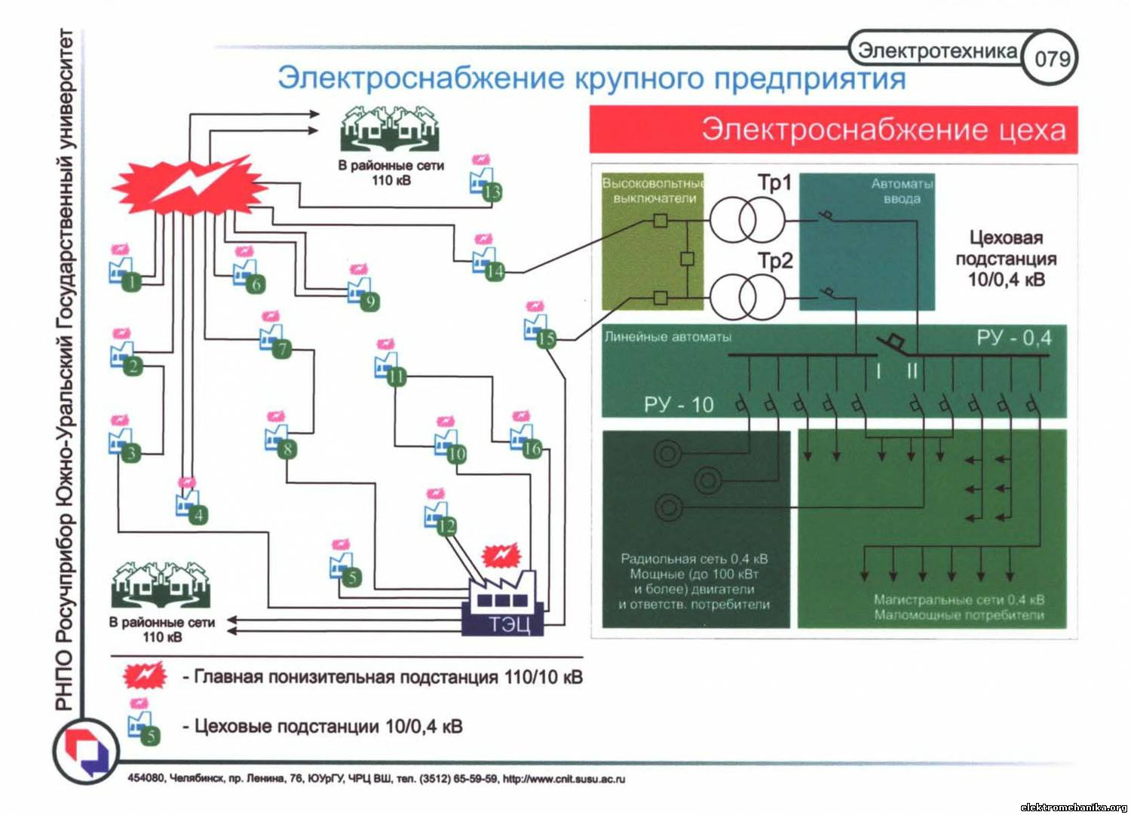
Reliability and guarantee of supply
Reliability and guarantee of power supply to the consumers of the microsystem will be completely determined by its structure: the composition of the generators, the electric network scheme and the type of electricity consumers - the less the guaranteed capacity of the generators, the lower the guarantee of uninterrupted power supply.
Notes:
For reliable power supply of consumers in different nodes of the power system need to get generators and electricity consumers could adjust the power within the cycle management of the balance of power.
.

Slide 6
Structure of installed capacity of power plants OF Russia in 2017
Power plants
Installed capacity, MW
UES of Russia total
Thermal power plant’s (TPP)
Water power plant’s (WPP)
Wind power plant’s (WindPP)
Solar power plant’s (SPP)
Nuclear power plant’s (NPP)
Notes:
To do this, the structure of the generators should be optimal, should ensure the reliability and security of power systems at maximum efficiency of their work. In UES of Russia such a structure is shown on the slide. And regulatory capacity of the plant is not less than 25% of the installed capacity of energosistemy.

Slide 7
utilization Ratio of installed capacity(%)
Region Year TPP WPP WindPP SPP NPP
Center
Middle Volga
Ural
Northwest
South
Siberia
Far East
Notes:
The composition of power plants varies significantly by region of the country. This is due to their construction and technolgies energy production. So, nuclear power plants, utilization of installed capacity is maximized and power plants based on renewable source of energy is minimal. The reason is the absence of power plants based on renewable energy sources guaranteed power.

Slide 8
development of continental energy systems
The most important directions:
Creation of a “Energy bridge" Russia-Belarus-Poland-Germany
Creation of the Baltic energy ring
Creation of Black Sea electricity ring
Establishment of the Asian continental energy rings :
  North-East Asian ring: Russia, China, Korea, Japan
  South-East Asian ring: Russia, China, Vietnam, Malaysia, Myanmar, India, Thailand, Indonesia, Cambodia
  Asian Continental energy ring that unites the North-Eastern and South-Eastern energy ring
Notes:
The development of world economic system involves the development of energy, primarily electrical. It is necessary to link the regions poor in energy resources and rich them in the unified energy system. Such systems can be national, continental, Intercontinental and global. However, the construction of interstate energetic systems require security of power supply of each of the participants of the interstate energy system. This will require the establishment of such a structure of the continental energy system, which does not depend on the global political situation. That is the energy system can be built on the principle of a distributed energy system.*

Slide 9
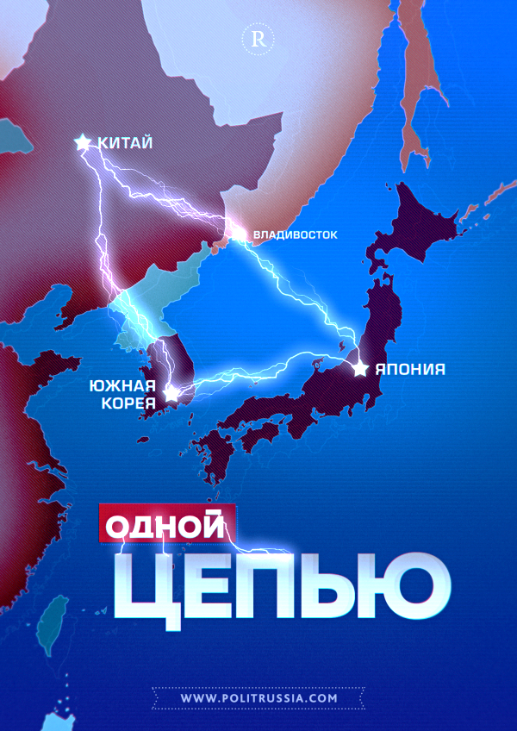
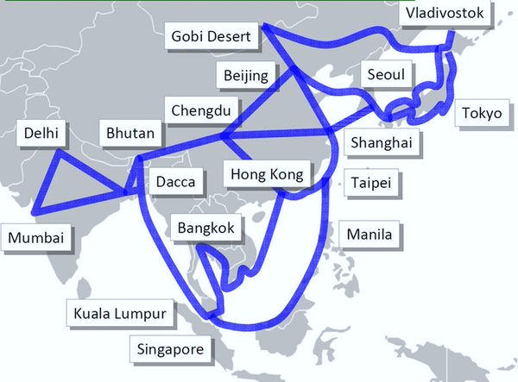
Asian Continental energy ring
Nort-Asia Ring
Continental Ring
Notes:
Now various options are being discussed Asian energy ring: network uniting Russia, North and South Korea, China and Japan. More ambitious plans include the continental power system of the country of ASEAN. A similar approach can be used for developing a continental energy systems of Europe, Asia, Africa, Latin America and Oceania. The US and British Commonwealth countries have not expressed intention to participate in these continental inter-state projects. So they are not included in the present scheme.

Slide 10
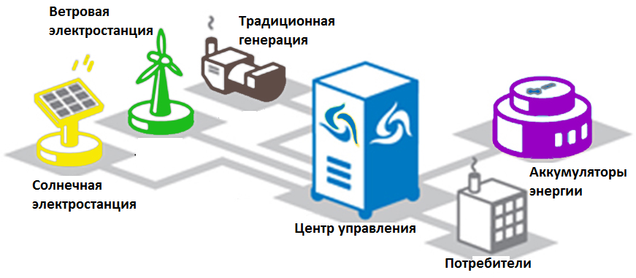
Distributed Energy system
- combination of:
traditional large power stations;
small gas-turbine installations;
small hydropower plants;
wind and solar power plants;
energy accumulators;
consumers and controllable loads, distributed throughout the power system.
Wind PP
Traditional generation
Energy
accumulators
Solar PP
Control Center
Consumers
Notes:
Optimal energy system should be built on the principle of distribution of functions, sources and management tools. An example of such a system to be the grid with solar, wind, hydraulic, thermal and other power stations, energy storage (electricity and heat) and managed by consumers energy. The most clear of such hybrid energy systems for energy nodes of low power, not related to the overall electrical network.

Slide 11
Distributed energy system – combining of MicroGrids
Control of power system consisting of a network of Micro Grids, it is much easier and commercial calculations more transparent and simple.
When the mismatch of the modes, parts of the power system is separated into an independent Micro Grid, each of which restores on their own, and payments for the supply of electricity are conducted on the value of intersystem power flows.
Wind PP
Traditional generation
Energy
accumulators
Solar PP
Control Center
MicroGrid
Consumers
MicroGrid
Notes:
Such nodes of the grid are considered as "microsphere" or Microgrid. Each Microgrid is one of the nodes of the power system of greater dimension. Thus is constructed a multilevel hierarchical system, each node of which is independent and self-balancing.

Slide 12
The attitudes of RES in the energy system
Power plant based on renewable energy do not have their own means of accumulation of energy resource
They don't have ensure capacity, i.e. power that is transferred to the consumer of electricity with a given guarantee of uninterrupted (usually (95-97)%), i.e. the Consumer is not getting the required power in the considered period of time only (3-5)% of the cases.
Notes:
Power plant based on renewable energy do not have their own means of accumulation of energy resource, such as coal storage, oil or hydrocarbon storage facilities power stations or reservoirs of large hydroelectric power stations.
They don't have firm capacity, i.e. power that is transferred to the consumer of electricity with a given guarantee of uninterrupted (usually (95-97)%).
This means that the consumer is not getting the required power in the considered period of time only (3-5)% of the cases.

Slide 13
Installation of renewable energy
Duplicate the capacity of the guaranteeing supplier of electric energy (thermal, nuclear, geothermal and other power plants).
Power non-redundant generators based on renewable energy cannot be more than the value of reserve capacity, production, and their use in Microgrid deprives the consumers of these systems of guaranteed power supply
Exception: areas of the world where the flow of energy is guaranteed (90-94)% (320-340 days of sunshine per year). In Europe and America guarantee the arrival of solar energy per year does not exceed 50%
Notes:
Power plant based on renewable energy do not have their own means of accumulation of energy resource, such as coal storage, oil or hydrocarbon storage facilities power stations or reservoirs of large hydroelectric power stations.
They don't have firm capacity, i.e. power that is transferred to the consumer of electricity with a given guarantee of uninterrupted (usually (95-97)%).
This means that the consumer is not getting the required power in the present Power plant based on renewable energy - duplicate the capacity of the guaranteeing supplier of electric energy (thermal, nuclear, geothermal and other power plants).
With the exception of those parts of the world where the flow of energy source (solar radiation, for example) is guaranteed (90-94)% or 320-340 days of sunshine a year.
In Europe and America guarantee the arrival of solar energy per year does not exceed 50%
Power non-redundant generators based on renewable energy cannot be more than the value of reserve capacity, production, and their use in Mikrogrid (MES) deprives the consumers of these systems of guaranteed power supplyатриваемый period of time only (3-5)% of the cases.

Slide 14
the work of installations of RES in the energy system
Backup installations of renewable energy guaranteeing the own or an external source
Smoothing surges of power energy storage devices of different types
Maintaining the power balance of the power system regulation of energy consumption
Notes:
There are three possible ways of incorporating renewable energy installations to the grid with the specified guarantee of supply to consumers:
Backup installations of renewable energy guaranteeing the own or an external source of energy. When you work in the centralized power systems reserve is about 20%, so the total working capacity of power plants by renewable energy sources, as a rule, does not exceed 20%.
Smoothing the jumps of the installed capacity of renewable energy using energy storage.
The balance of power of the power system regulation of consumption of electric and thermal energy.

Slide 15
Establishing the continental grid as a system of distributed type
The construction of large energy systems (LES) is a regional, national, continental or Intercontinental – requires a new paradigm: distributed energy system with a self-balancing energy centers - Microgrid.
Such systems provide reliability and energy safety of each power host LES
Notes:
The construction of large energy systems (BES) is a regional, national, continental or Intercontinental – requires a new paradigm: distributed energy system with a self-balancing energy centers - Microsystems.
Such systems provide reliability and energy safety of each power unit BES

Slide 16
Requirements to host’s the distributed grid
The link for the operating and standby power
The security of its own energy
The possibility of reducing the guarantee of consumption if necessary
Guaranteed power supply is only the infrastructure host’s of LES
Notes:
The maximum availability of own energy resources (minimal dependence on energy supplies)Maximum environmental friendlinessThe maneuverability necessary to ensure a sustainable energy supply power unit (provided through its own technological equipment and energy storage in the processing chain generation)

Slide 17
Requirements to generator’s the distributed grid
Minimum dependence on energy supplies
Maximum environmental friendliness
Maneuverability (to ensure sustainable energy supply power unit)
Notes:
The maximum availability of own energy resources (minimal dependence on energy supplies)
Maximum environmental friendliness
The maneuverability necessary to ensure a sustainable energy supply power unit (provided through its own technological equipment and energy storage in the processing chain generation)

Slide 18
The host’s structure of BES with installations based on renewable energy
SolarPP
consumer =
Controller
Controller
Accumul
Accumul
Bus =
invertor
invertor
Connect BES
Bus ∼
Accumul
Accumul
Accumul
Accumul
Controller
Controller
Controller
Controller
WindPP
WPP
DiselPP
consumer ∼
Notes:
The structure of virtual MES as host of Great Energy System, generators based on renewable energy

Slide 19
optimization of distributed energy system structure
to find a optimal complex power system of electrical and thermal energy for electrical and thermal energy consumers and, in which the degree of duplication of generating capacity of complex power system will be minimal, and the guarantee of uninterrupted power supply of energy consumers will be maximum.
Notes:
to find such a combination of consumers of electric and heat energy of various types and this combination of sources of electric and thermal energy, in which the degree of duplication of generating capacity will be minimal, and the guarantee of uninterrupted supply of consumers with all kinds of required energy will be maximum.

Slide 20
The algorithm for solving the problem
The definition of electric power consumption graph;
The calculation of the balance of power during the sequential addition of various types installations based on renewable energy to increase their numbers (method of successive approximations);
Definition of the technical and economic characteristics of the equipment of an Microgrid;
Evaluation of infrastructural factors that affect the placement of plants based on RES in the region;
Choosing the optimal structure according to economic criteria.

Slide 21
CONCLUSION
Energy systems of the future should be economical, reliable and safe, should ensure the maximum continuity of energy supply to energy consumers in all regions and continent’s
This can be achieved only with the development of energy systems with installations based on RES based on the paradigm of distributed energy systems.

Slide 22
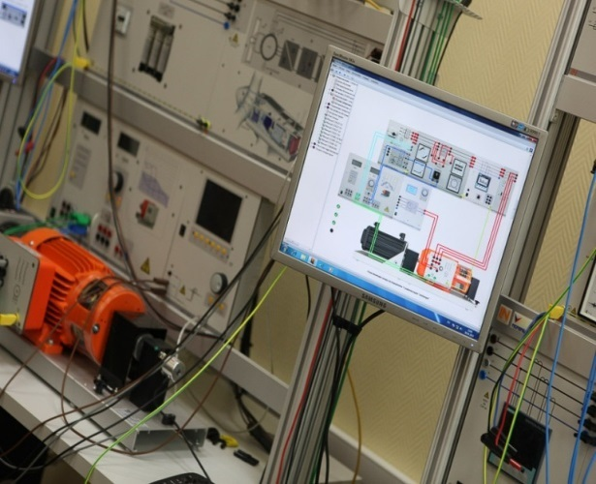
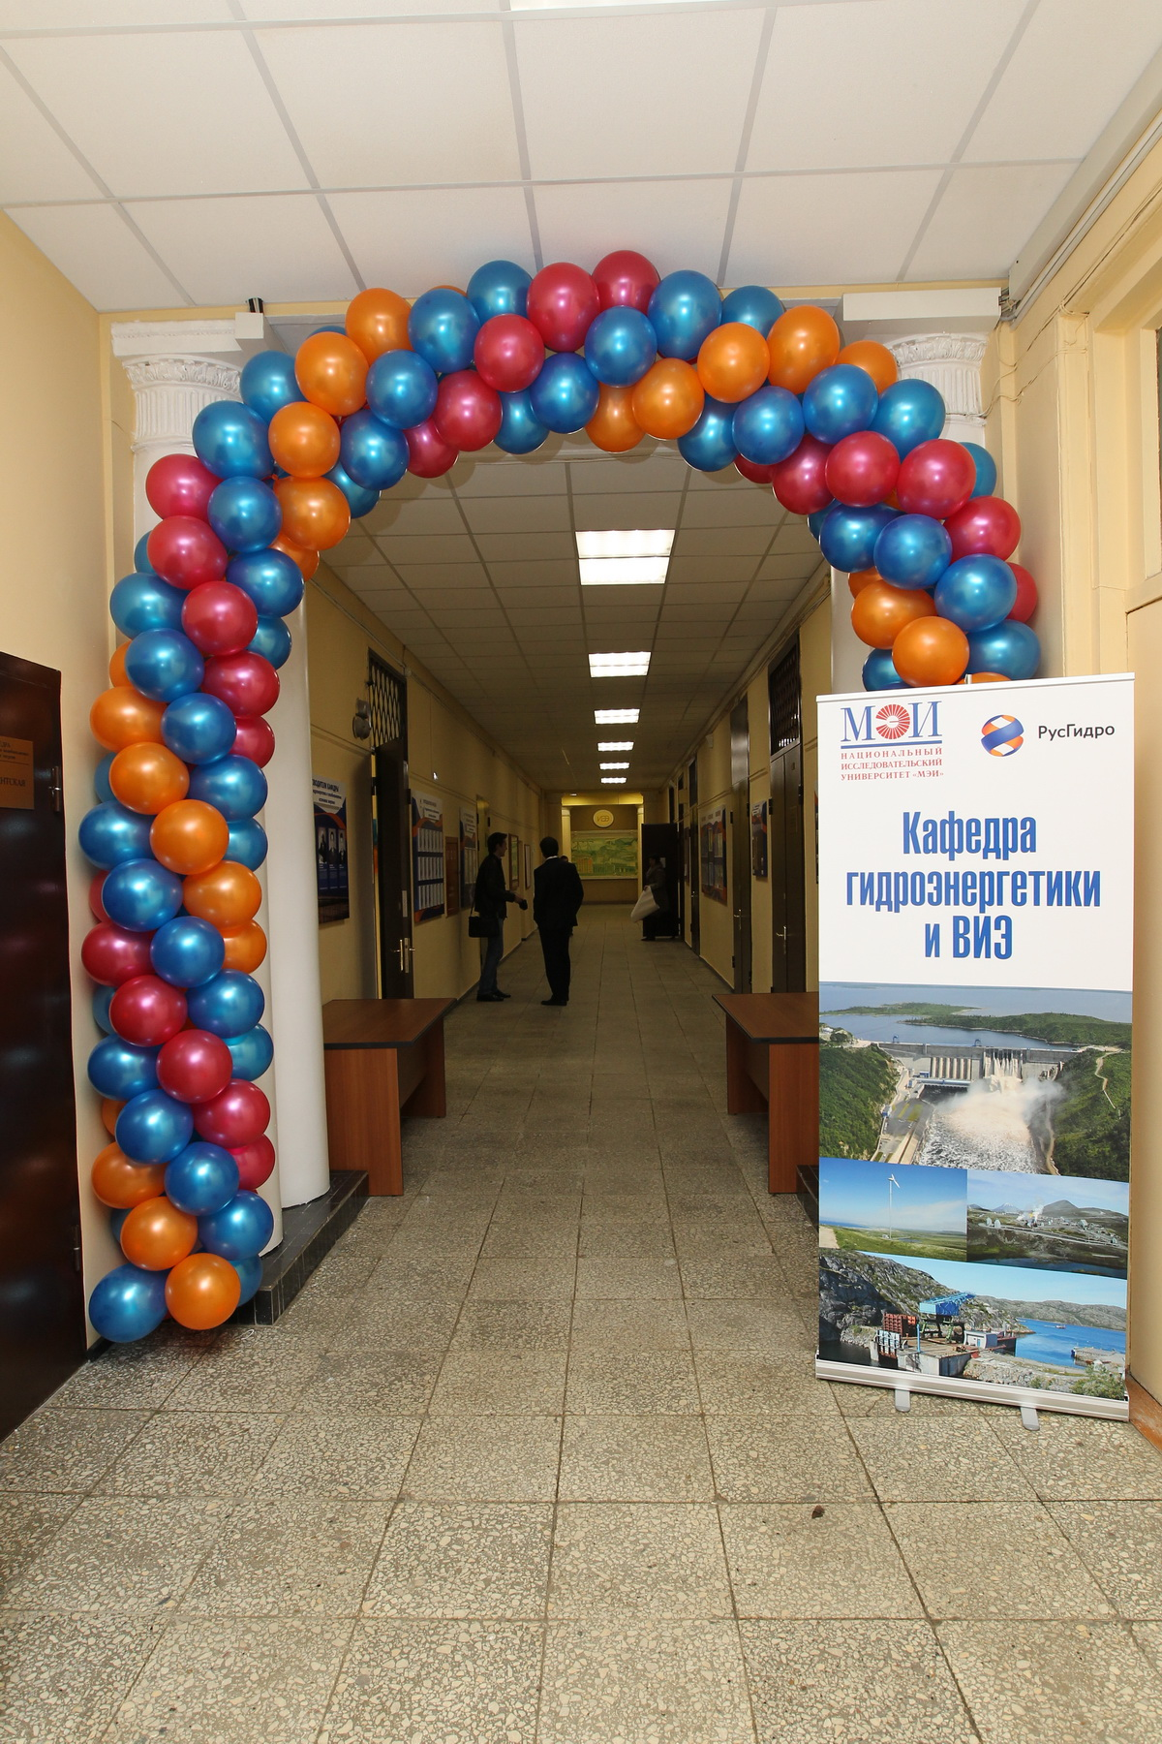
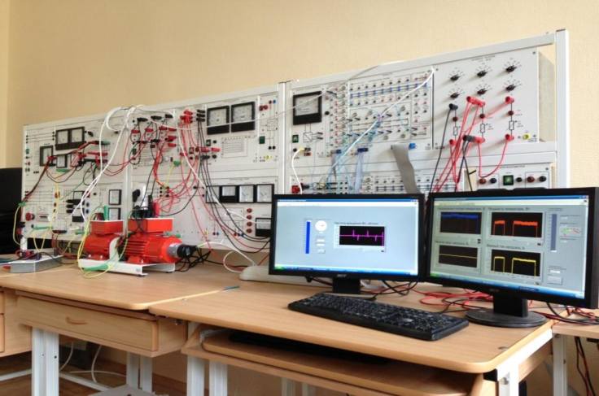
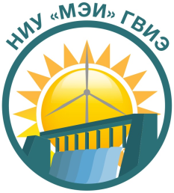

Thank you for your attention!
Contact:
111250, Moscow,
Krasnokazarmrnnaja str., 17
Phone +7 495 362-72-51
GVIE@mpei.ru,
KafedraGVIE@mail.ru
http://MPEI.ru

