Slide 1
Determining the optimal placements of renewable power generation systems using regional geographic information system
Prof. Tyagunov M. G. ,
PhD Zay Yar Lin :
the Department of Hydropower and Renewable Energy,
Moscow Power Engineering Institute, Moscow, Russia.

Slide 2
Determining optimal placements for renewable energy production
Estimating the potential of renewable energy in a given area
Examining the factors affecting the placement of renewable energy facilities in the given area
Creating the Geoinformation System (GIS) for Renewable Energy Sources (RES)
Selecting the optimal hybrid power systems to cover electrical demand of the given area using the created GIS for RES

Slide 3
Estimating the potential of renewable energy in a given area
This step includes the following processes:
Selecting the regional databases for RES on each 1x1
geographical degree.
Defining methods and models for estimating potential of RES.
Estimating potential energy of renewable energy resources in the
given area.

Slide 4
Estimating the potential of renewable energy in a given area
This step includes the following processes:
Selecting the regional databases for RES on each 1x1
geographical degree.
Defining methods and models for estimating potential of RES.
Estimating potential energy of renewable energy resources in the
given area.

Slide 5
Choosing Data Bases for GIS RES Myanmar
Solar radiation data, wind speed data, height of tide and water flow rate data are available from database of NASA, Russian's weather, Weather timetable, Meteonorm, Total Tide, WMO and other.
To verify the mathematical models, data from Ministry of Agriculture and Irrigation Myanmar and Ministry of Electric Power Myanmar is used.

Slide 6
Comparison of existing GIS of the World
GIS for RES in the world | IRENA | SWER | 3TIER | GIS for RES Myanmar
Global | + | + | + | -
Regional | - | - | - | +
Solar radiation data | + | + | + | +
Wind speed data | + | + | + | +
Water flow rate data | - | - | + | +
Tidal range data | - | - | - | +
Maps of gross renewable energy potential | - | - | - | +
Maps of technical renewable energy potential | - | - | - | +
Map of electricity stations based on RES | - | - | - | +
Map of population density | - | - | - | +
Maps of transport network | - | - | - | +
Map of Possible flood areas | - | - | - | +
Map of Seismic Hazards Zones | - | - | - | +
Map of Special protected areas | - | - | - | +
Map of Power consumption over the country | - | - | - | +
Methods and algorithms for calculating the gross and technical resources and parameters of the projected power plants based on RES | - | - | - | +

Slide 7
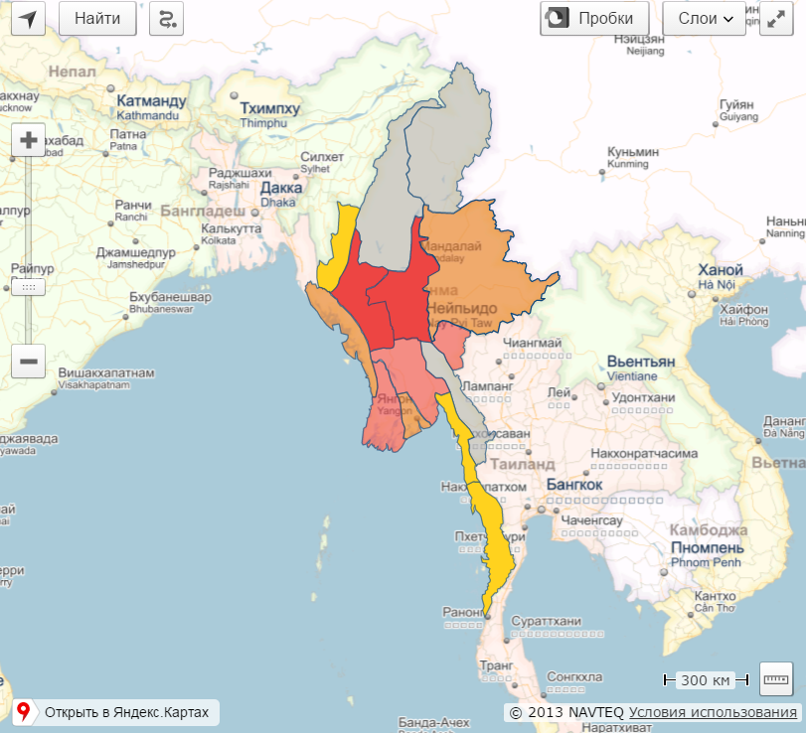

The gross potential of solar power in Myanmar (W / m²)

Slide 8
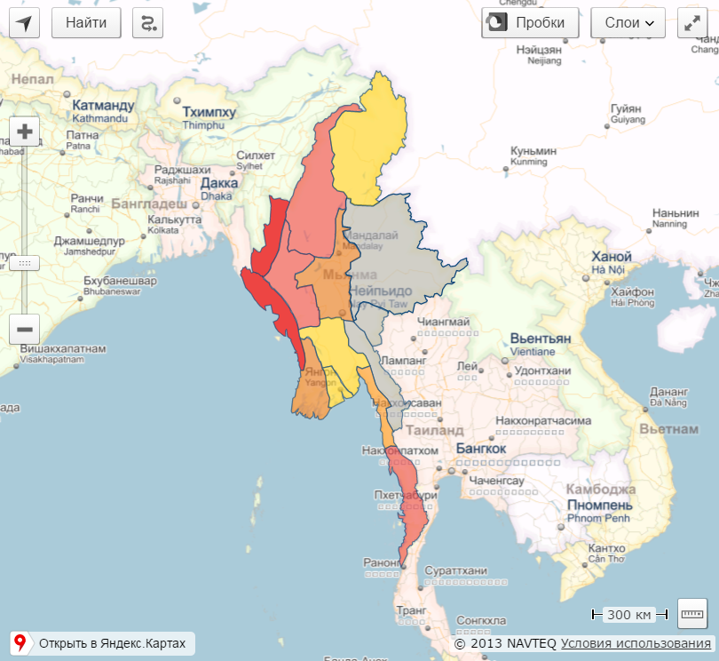

The gross potential of wind power in Myanmar (W / m²)

Slide 9
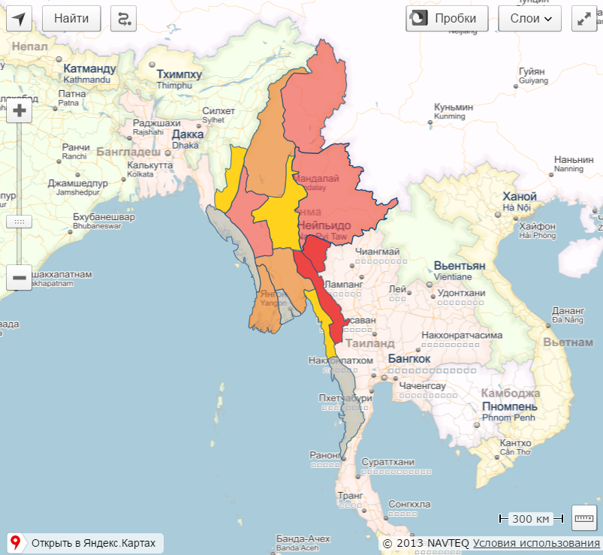

The gross potential of small hydro power in Myanmar (W / m²)

Slide 10
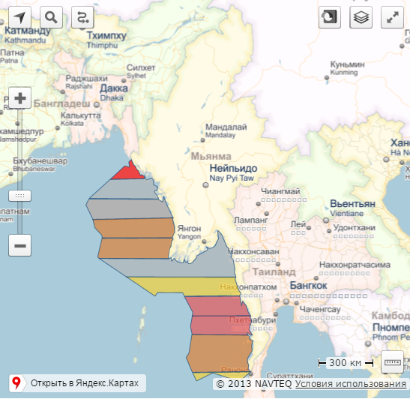

The gross potential of tidal power in Myanmar (W / m²)

Slide 11
Factors affecting the placement of renewable energy facilities in a given area are divided into two categories
1. Factors to be considered in the placement of power plants based on renewable energy sources:
a) Land relief
b) Availability of RES
c) Population density
d) Energy demand
e) The locations of energy consumers and existing and planned
power transmission lines
f) Locations of existing and planned power stations
2. Limiting factors to be considered in the placement of power plants
based on renewable energy sources:
a) Transport network
b) Possible flood areas
c) Seismic hazards zones
d) Special protected areas

Slide 12
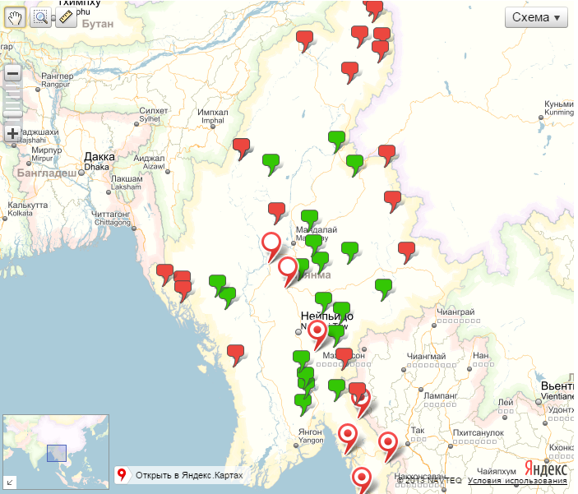
Map of existing and planned power plants based on renewable energy

Slide 13
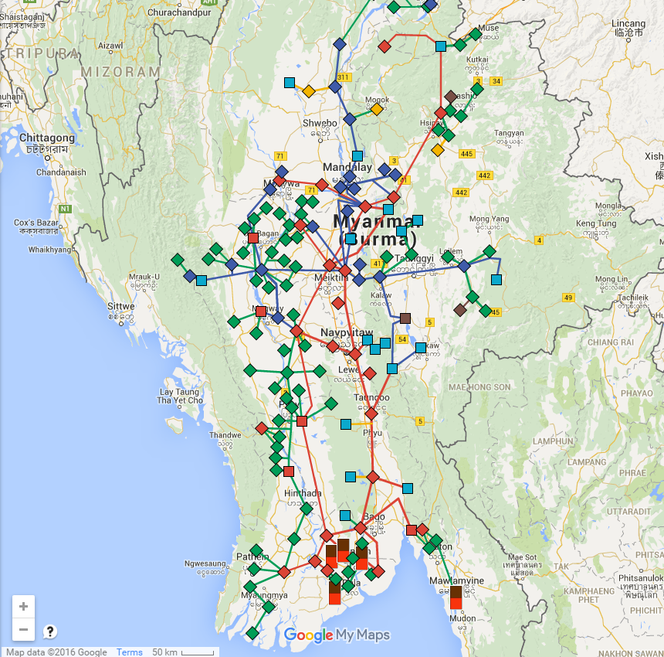

Map of national grid network in Myanmar

Slide 14
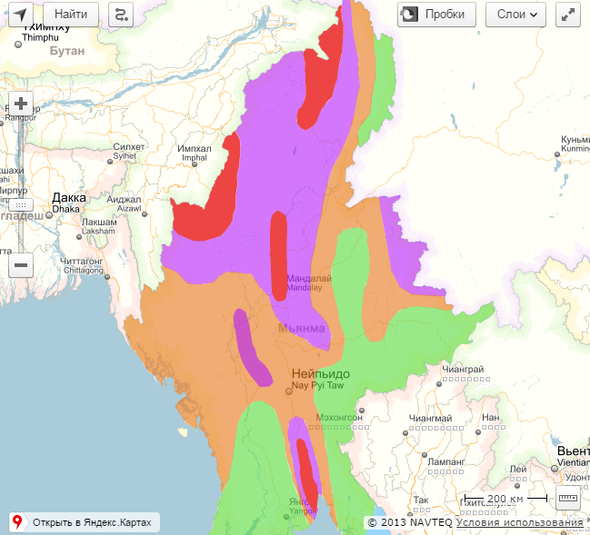
The seismic zone map of Myanmar with the European macroseismic scale

Slide 15
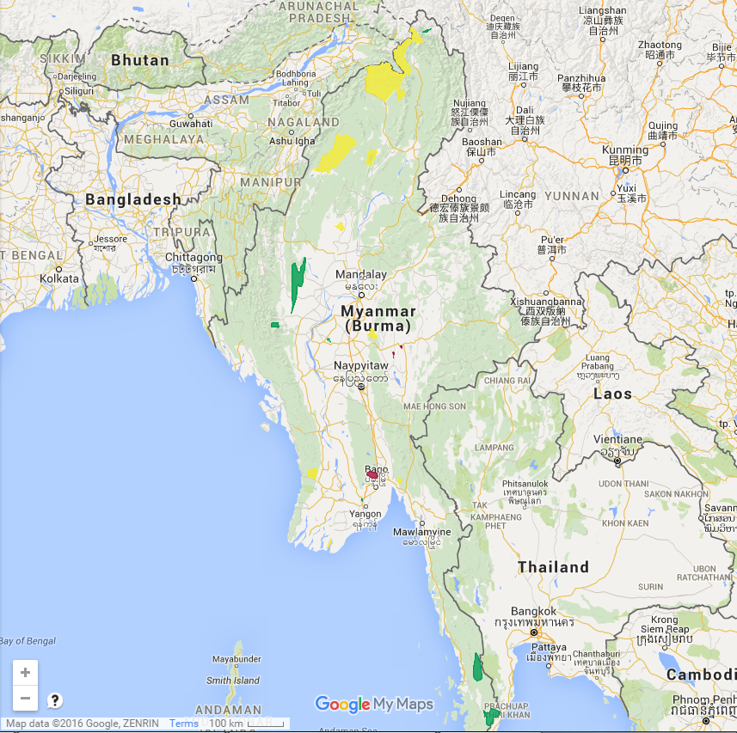
Map of protected areas in Myanmar

Slide 16
Selecting the optimal hybrid power systems for electrical demand of the given area
This step includes the following processes:
1. Examining the technical and economic characteristics
of the equipments of hybrid power systems.
2. Defining the algorithm for calculating the balance of
power in hybrid power systems.
3. Finding the optimal hybrid power systems with
minimum total costs for the settlement period by
considering factors affecting the placement of
renewable energy facilities.

Slide 17
Hybrid power system
Hybrid power system is a system that consists of the following parts:
Energy storage
Mechanical energy storage
Pumped storage hydropower
Flywheel energy storage
Thermal energy storage
Cool water, hot water storage
Molten salt storage
Chemical energy storage
Battery storage
Hydrogen storage
Generation
Electrical energy generation
Solar power generation
Wind power generation
Small hydro power generation
Tidal power generation, etc
Heat energy generation
Solar collector
Geothermal, etc
Consumption
Electrical Load
Heat Load

Slide 18
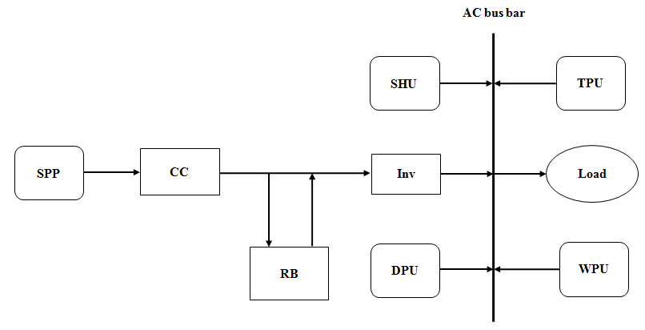
Figure . Model typical HPS for electric power supply of an isolated power system.
where SPP – solar photoelectric panels, SHU – small hydropower units, WPU – wind power units, TPU – tidal power units in the coastal regions, DPU – diesel power units, RB – Rechargeable Batteries, CC – charge controller, Inv – Inverter, Load – consumers of electricity.

Slide 19
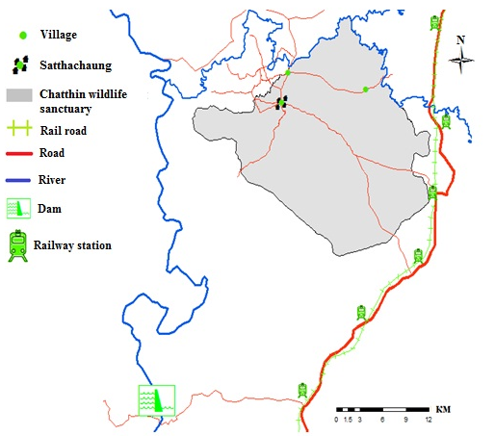
Saturation of Village Satthachaung
Village Satthachaung is located in a wildlife sanctuary in the central plains region of Myanmar near the Daungyu River.
In the village 135 households, a school, a polyclinic, a church, a market, a shop, a cafe, etc.
The average number of one family for each household is 5 people.
Power supply - using of their own generators.
The maximum value of power consumption is 225 kW.
The annual electricity consumption is 1342 MWh.
The price of diesel fuel is 1.2 $ / liter.
Regional GIS of the Chatthin wildlife sanctuary (23 ° 6 'N 95 ° 5' E)

Slide 20
Fig. The average monthly data of the solar irradiance, wind speed and water flow rate in the village.
Notes:
As shown in Fig., during the rainy season (from July to September), when the solar irradiance is minimum, the wind speed and river flow rate increase, and when the wind speed and river flow rate are minimum, the solar irradiance increases. Therefore, the parallel operation of SPP, SHU and WPU can improve the reliability of the power supply of the village.

Slide 21
The main indicators for the optimal variant of HPS
Units in HPS | Model | Installed capacity | Numberof unit | Capacity factor, % | Usage of all units in HPS, %
SPP | PLM-300P | 300kW | 1000 | 13 | 26
WPU | JFNH | 50kW | 10 | 31 | 12
SHU | XDHY-50 | 150kW | 3 | 37 | 36
DPU | NENJO | 255kW | 1 | 12 | 20
batteries | Kang Li Da | 540 kW.h | 260 |  | 6
Fig. Comparison of the total costs through the period of 20 years for only DPU and HPS.
Notes:
Using the diesel price of 1.2 $/liter and a fuel consumption of DPU 0.4 liter/kWh, the payback period of the HPS is 6 years (see Fig.10) and through the settlement period of 20 years, power generation of RES is up to 80% of the energy consumption of village.

Slide 22
CONCLUSION and FUTURE OUTLOOK
The data from GIS for RES should be reliable and the reliable data can be obtained from a certain region. So in this work regional GIS for RES is created for Myanmar. To get the reliable data for Myanmar verified meteorological data of RES such as incidence of solar radiation, water flow rate of rivers, wind speed and direction, temperature, tidal range, etc in the area of the country is used.
At present, many rural residents live with little or no electricity. For rural consumers of Myanmar, the use of RES is one of the best solutions for replacing the use of fossil fuels. To use RES effectively in electricity power supply, the first thing to do is determine where RES power plants should be placed. To determine the location of new prospective power plants based on RES prototype of GIS for RES is used for Myanmar.
GIS for RES of Myanmar provides a new, fast and convenient way to obtain information about the potential of RES and factors affecting the placement of renewable energy facilities in a given area. The developed GIS is designed to estimate the possibility and advisability of construction of power plants based on renewable energy in the given area by considering factors affecting the placement of renewable energy facilities in this area.
In this work many variants of HPS which consist of different types and different amount of SPP, HPU and SHU are compared and optimal variant is chosen for the power supply to village. Using the diesel price of 1.2 $/liter and a fuel consumption of DPU 0.4 liter/kWh, the payback period of the HPS is 6 years (see fig.20) and through the settlement period of 20 years, power generation of RES is up to 80% of the energy consumption of village.
However, work on the GIS for Myanmar is not finished yet, the system will be developed and supplemented. At future similar GIS for RES for all nations using reliable meteorological data should be created and all should be united and will become global GIS for RES. At that time every one can obtain information about the potential of RES and factors affecting the placement of renewable energy facilities for all area from this global GIS for RES and can estimate the possibility and advisability of construction of power plants based on RES in the given area using global GIS for RES.

Slide 23
Thank you for your attention

