Slide 1
Academic Colloquium
“MPEI-Riedle Foundation-FAU-Siemens
Cooperation“
Moscow, MPEI, June 1, 2018

Slide 2
Objectives of the Rd-Foundation*
To support teaching and research in the field of power generation and energy conservation at the University Erlangen-Nuremberg FAU and the Moscow Power Engineering Institute MPEI by
-Grants and scholarships for students and scientists for Master, Diploma and PhD Theses in Germany and in Russia
-Research projects carried out by students in either country
-Siemens Energy and Siemens CT Moscow will support information exchange meetings of Foundation graduates
*The funds for the Foundation came from the Global Energy International Prize 2005 and the Global Energy Foundation , Moscow

Slide 3
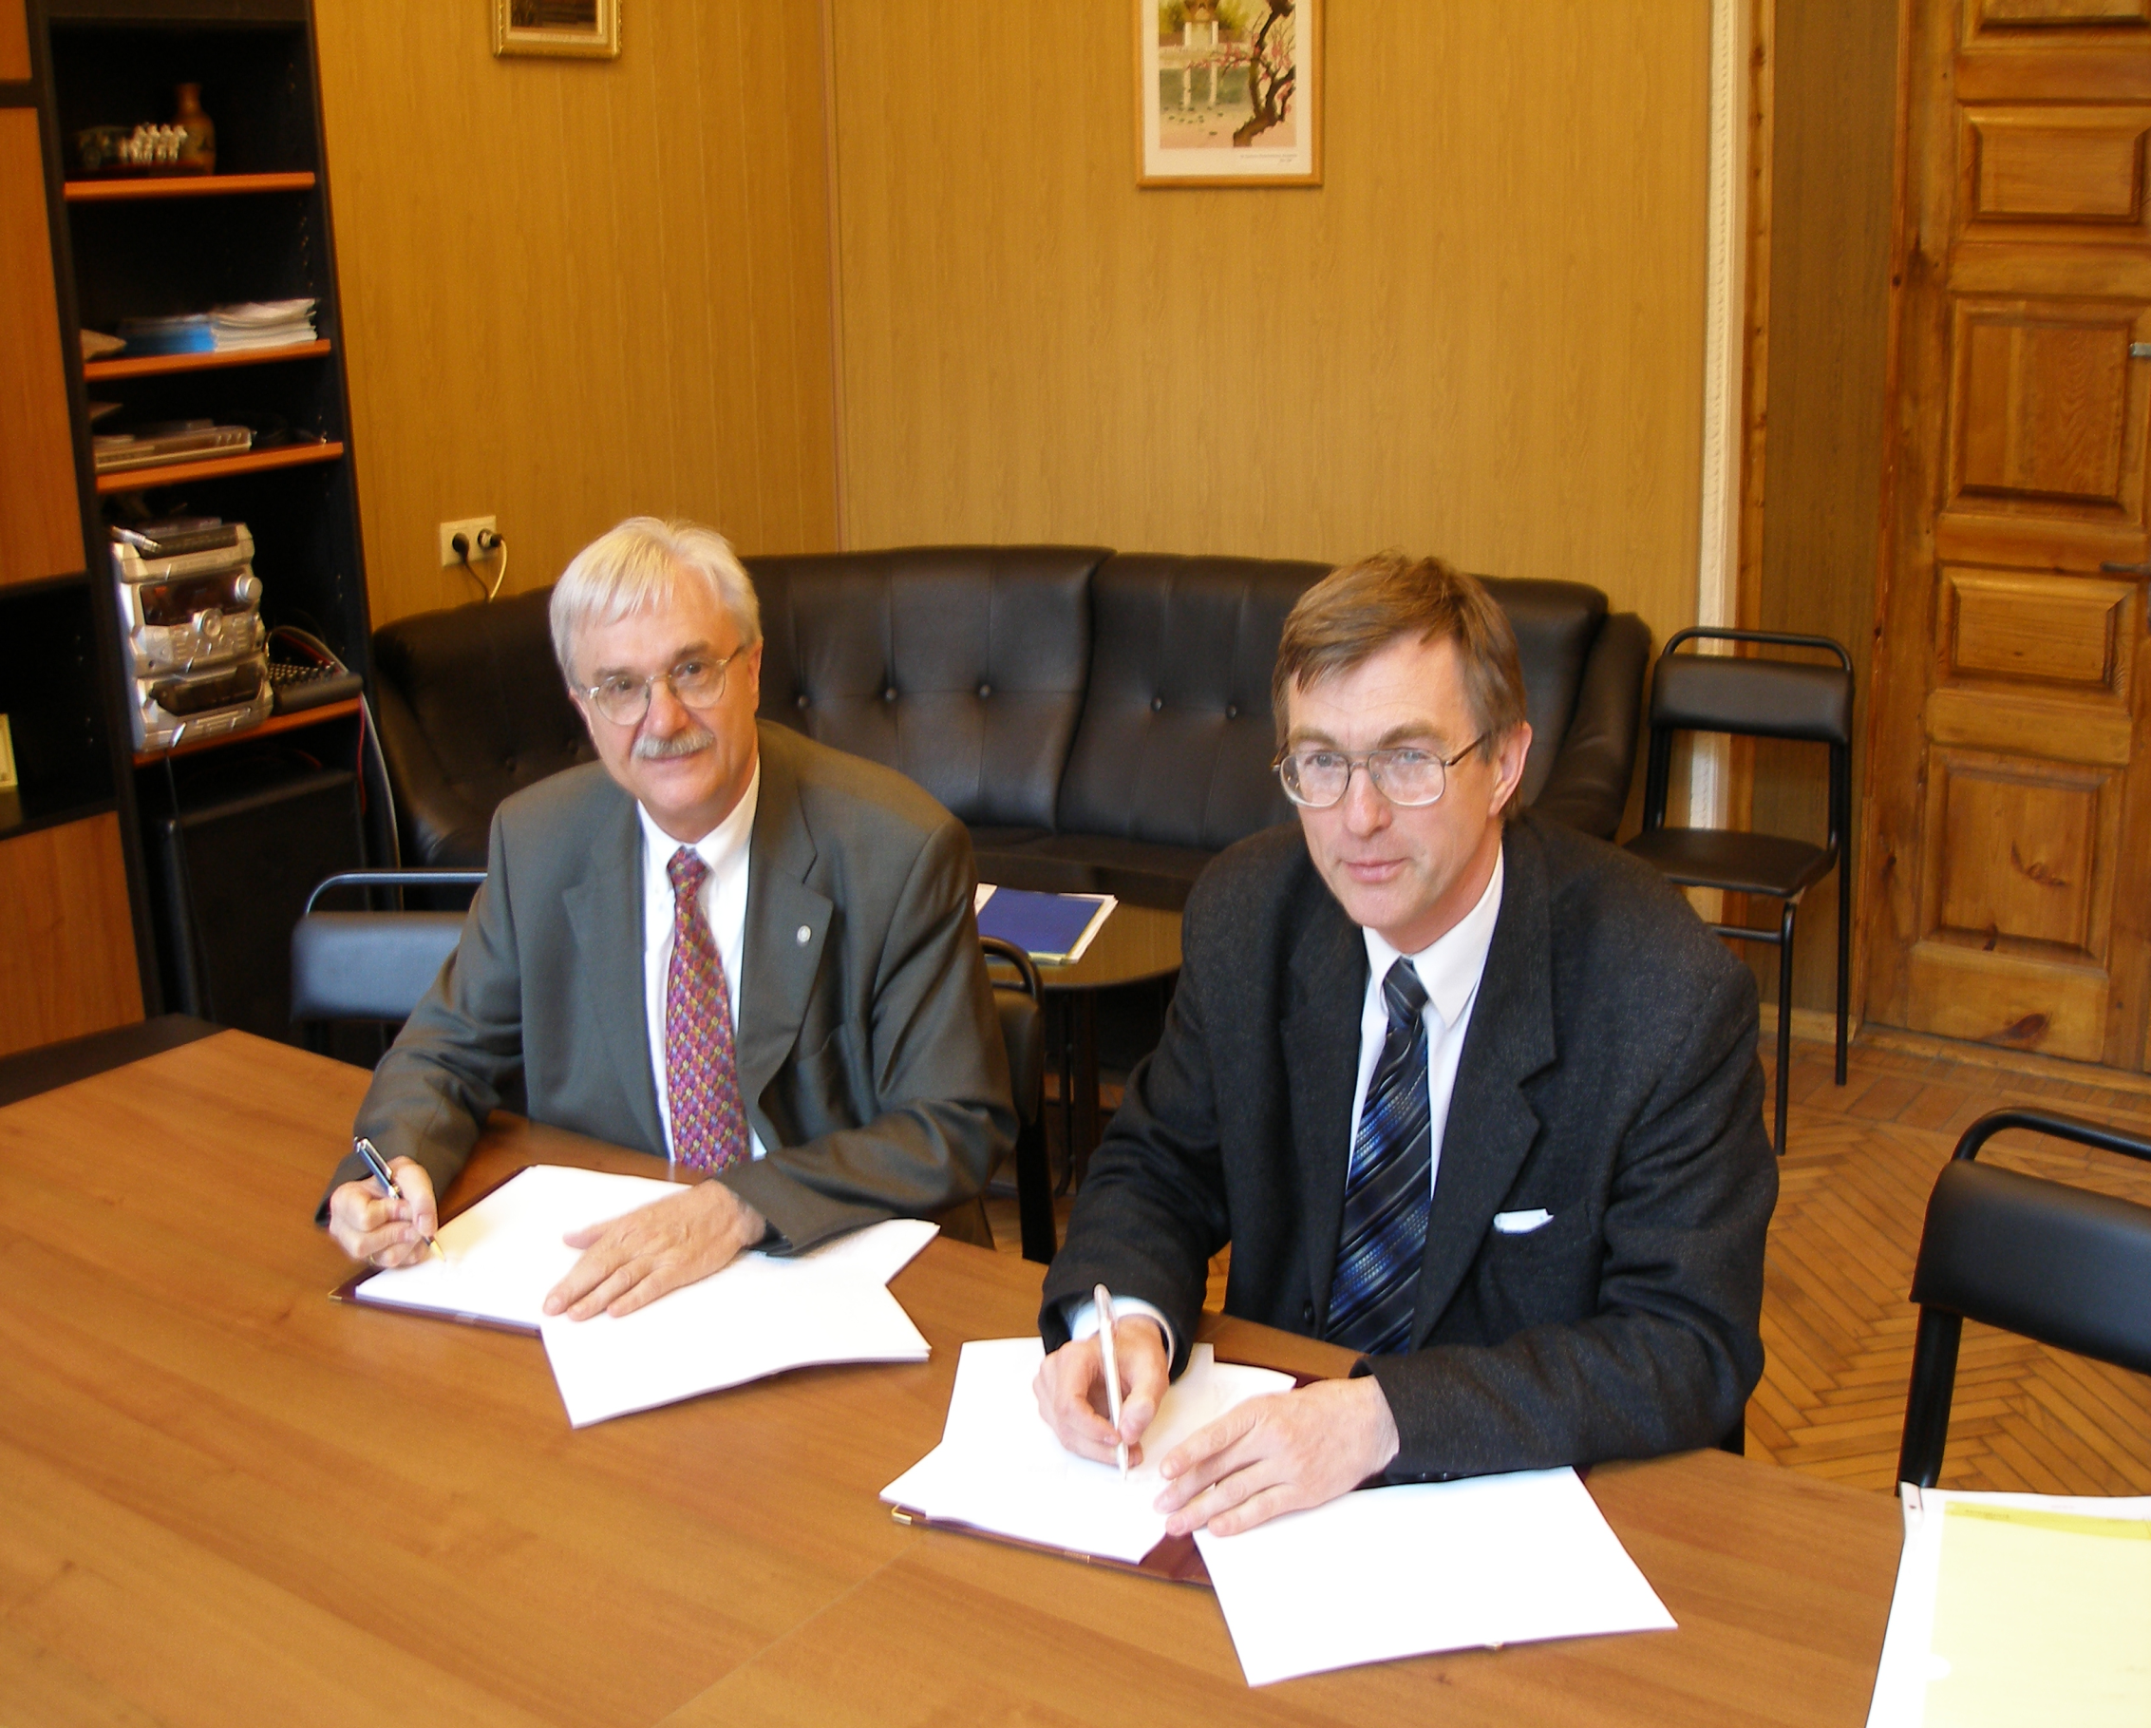

Slide 4
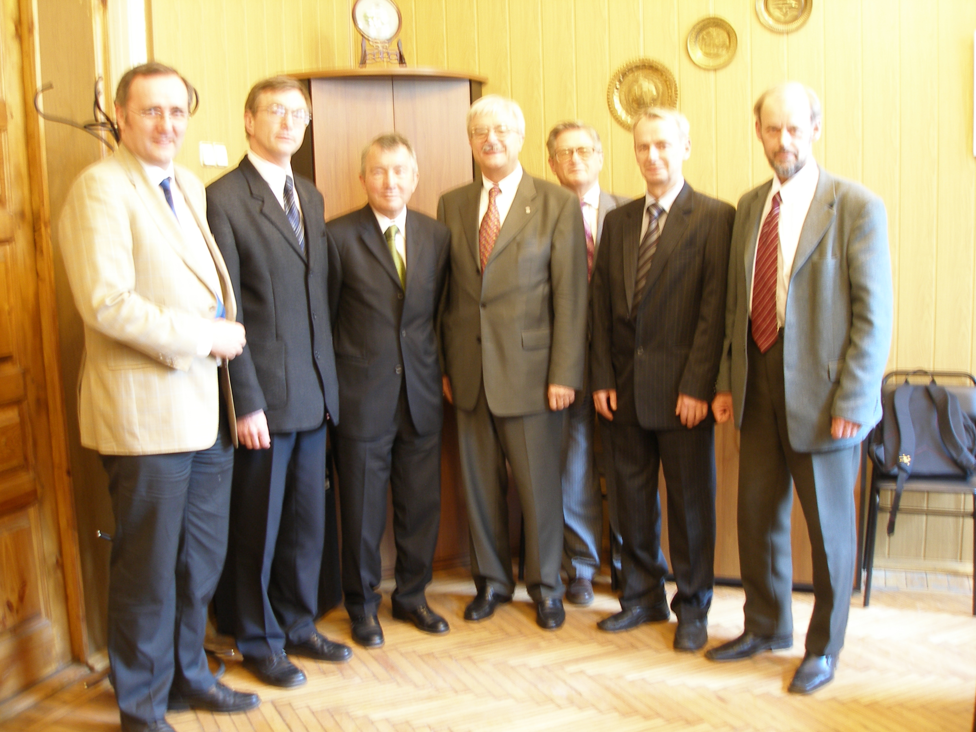

Slide 5
28 MPEI students have come to Germany (Status March 2018)
-Sergey Afonin
-Inna Ivanova
-Michael Chernyaev
-Lyubov Grobova
-Marina Kovaleva
-Ruslan Dzumagaliev
-Alexander Baranov
-Alexander Uchevatov
-Ilya Gregorev
-Michael Formenko
-Alexander Belyaev
-Konstantin Kolchev
-Alexander Anochkin
-Irina Orepina
-Dmitriy Mamaykin
-Anna Guseva
-Vadim Zelenov
Vladimir Kindra
Kristina Komova
Anastasia Schemanskaya
Natalia Fedorova
DmitryDenishuk
Maria Noskova
Dr. I. Kruzilov
Nikolay Kartchenko
Tatiana Zueva
Natalia Gavrilova
Evgeniy Striukov
17 at Erlangen University
11 at Siemens

Slide 6
18 MPEI students supported in Moscow
S. Bazuk Olga Braginskaya
S. Popov Maria Noskova
M. Shustov Nataliia Fedorova
Alexander Markov Dmitry Denishuk
Anna Nikolaeva
Irina Astafeva
Alexander Utschevatov
Ivan Poddubnij
Ilya Gregorev
Dimitry Mamaykin
Anastasia Denisova
Irina Orepina
Vadim Zelenov
Anna Guseva

Slide 7
Alumni Club Log Book
Table of Content
-News
-Scope of the Logbook
-Intent of the Rd-Foundation
-Grant Holders in the past years
-Project offers in the coming year

Slide 8
Alumni book

Slide 9
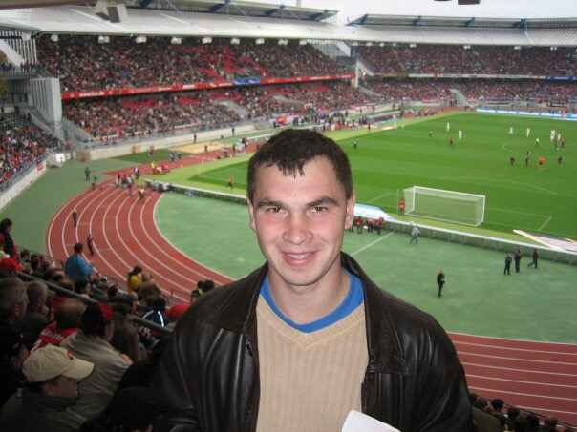
Sergey Afonin

Slide 10
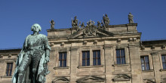
Ilya Grigoryev

Slide 11
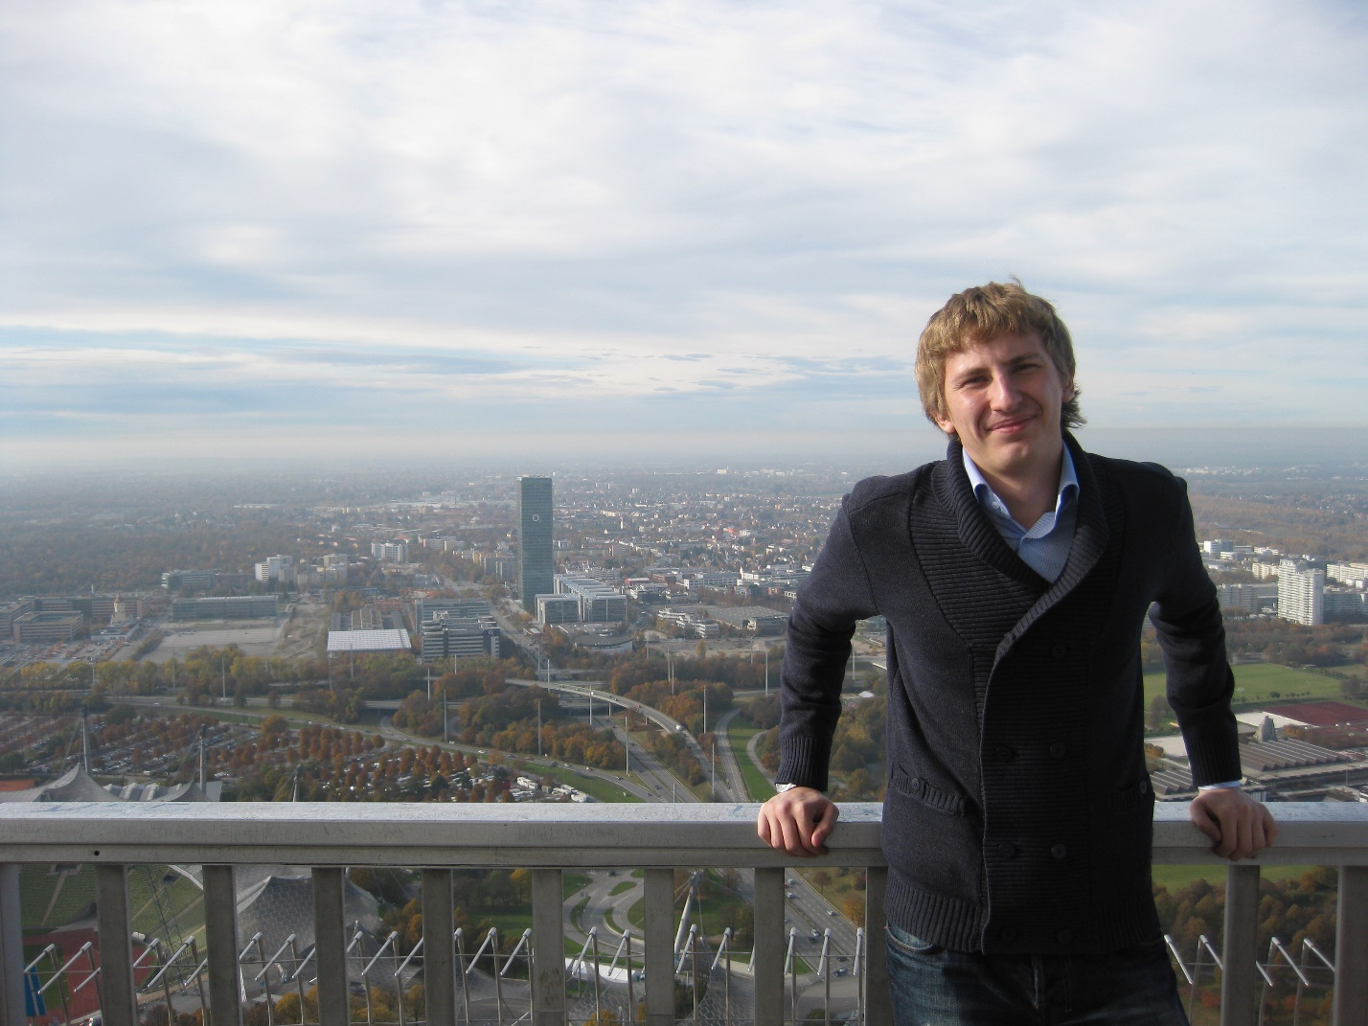
Michael Formenko

Slide 12
Alexander Belyaev

Slide 13
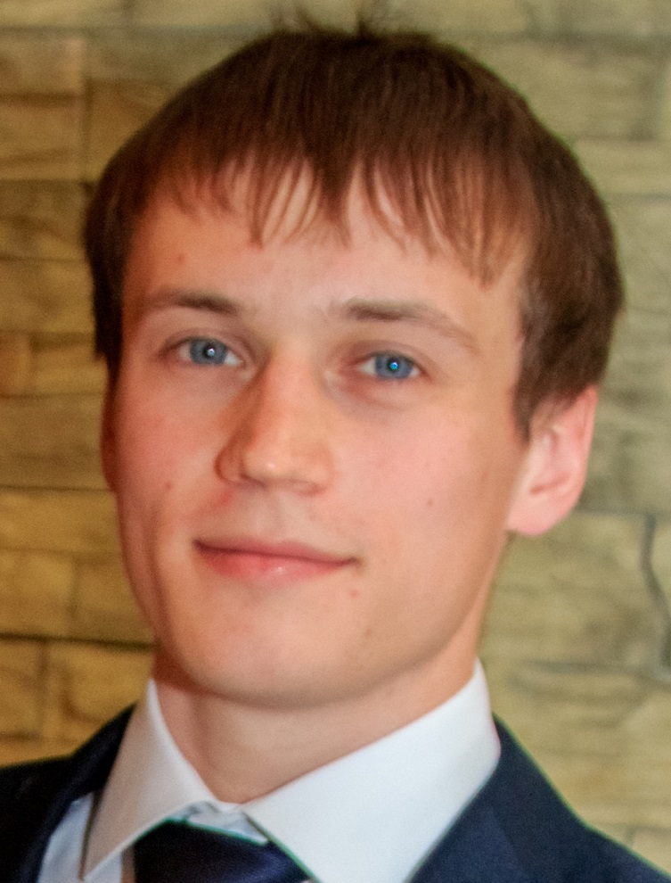
Vadim Zelenov

Slide 14
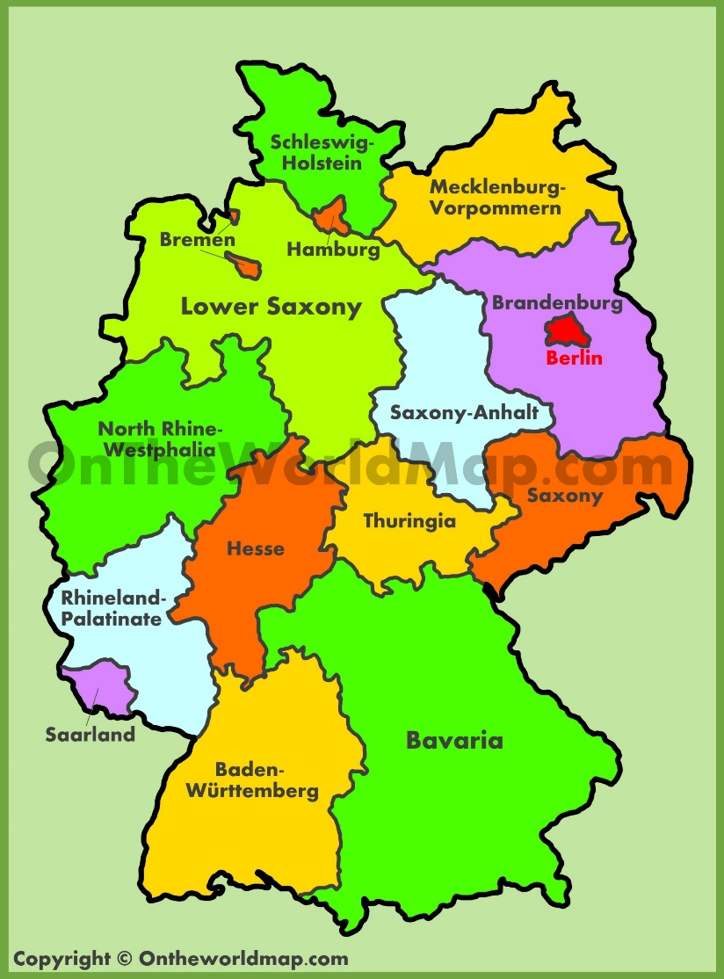
Erlangen
Renningen

Slide 15
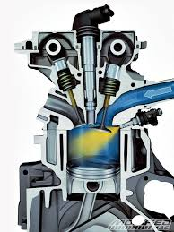
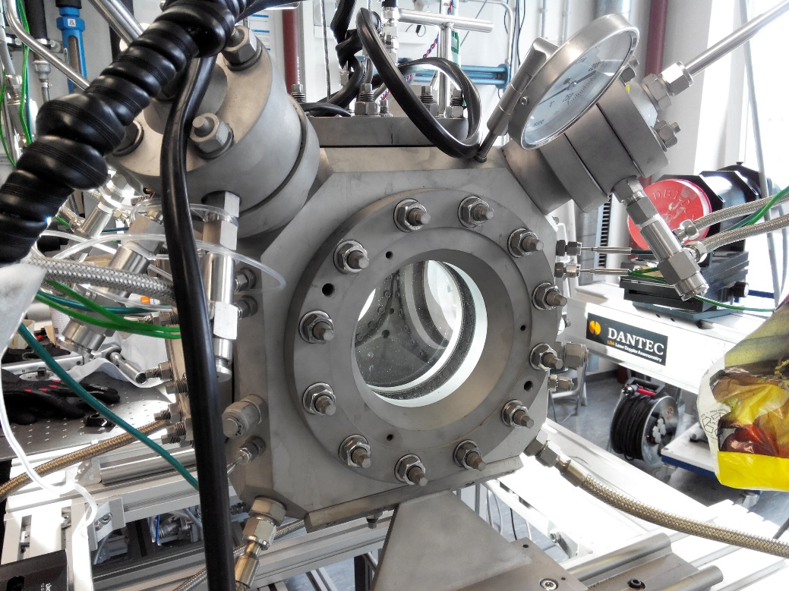


LTT Erlangen

Slide 16

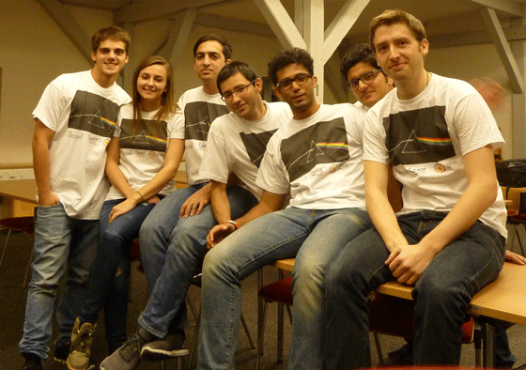

Slide 17
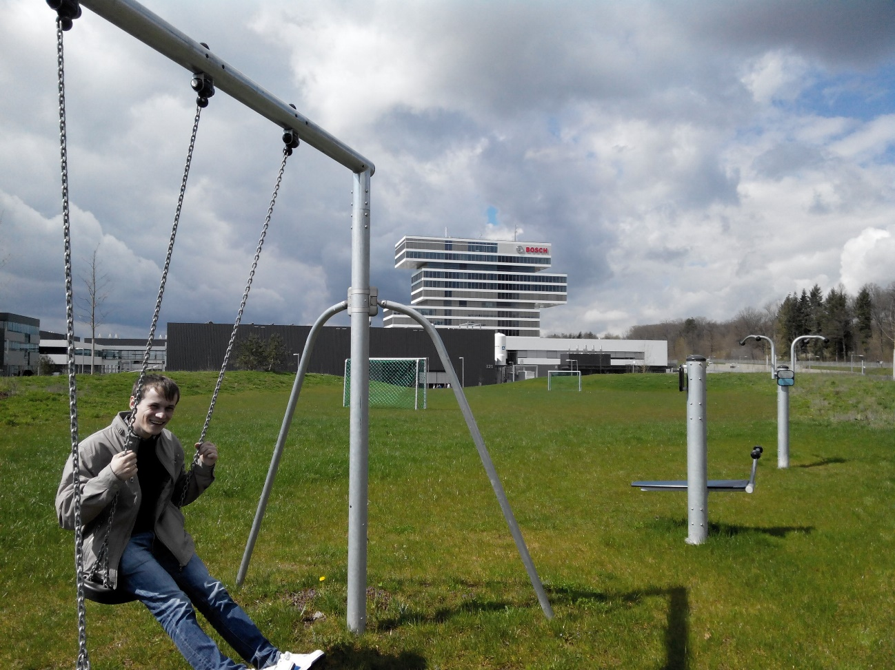
Bosch Renningen

Slide 18
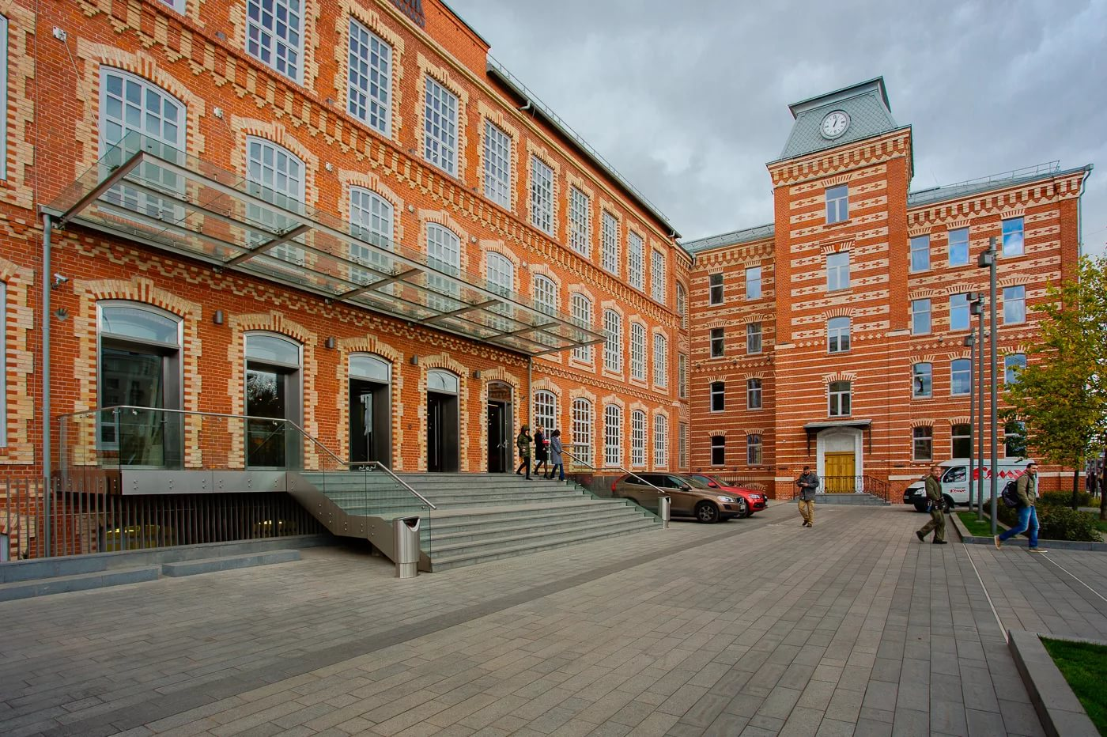

Publicis media Moscow
International Advertisement agency

Slide 19
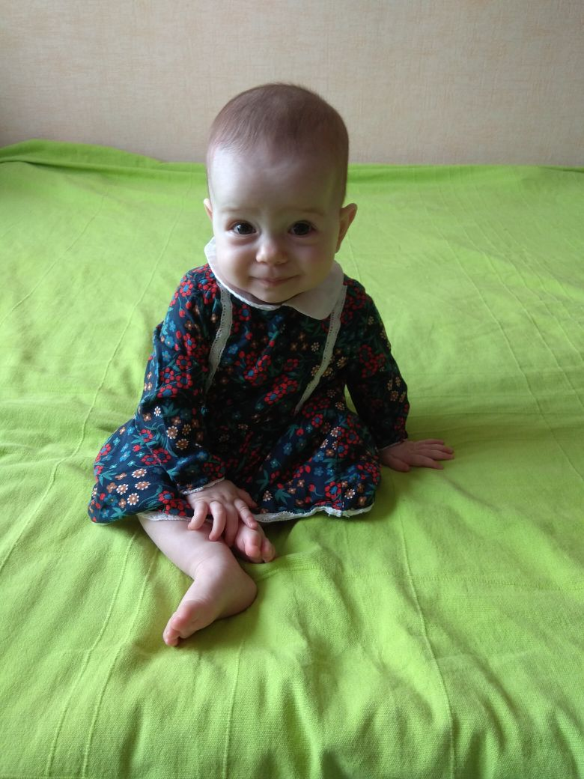
Questions???

Slide 20

Kristina Komova

Slide 21
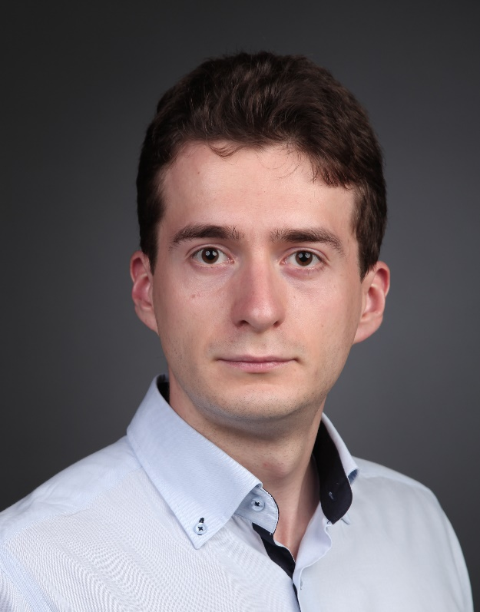
Vladimir Kindra

Slide 22
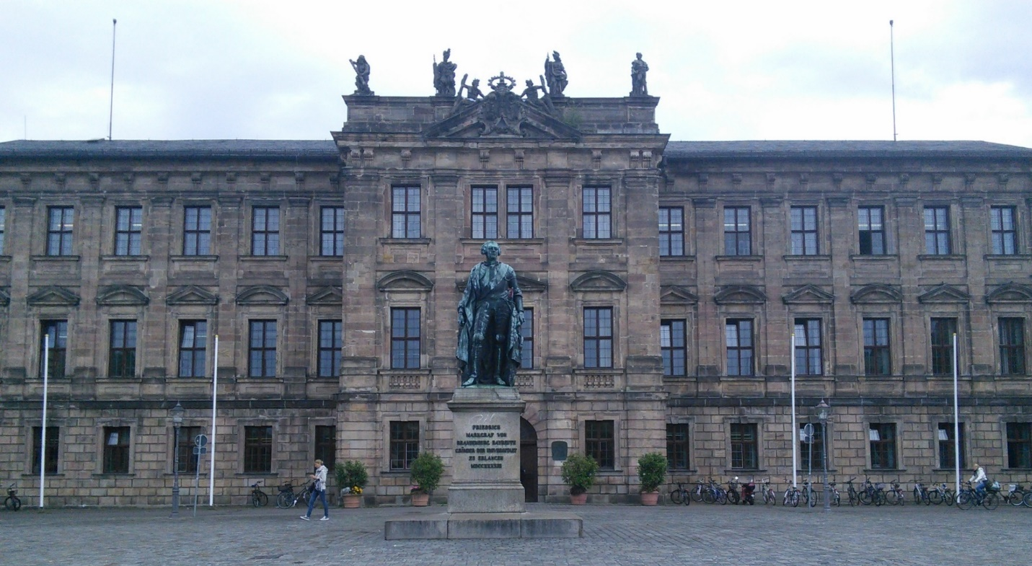
Internship in University of Erlangen-Nuremberg 2014-2015

Slide 23
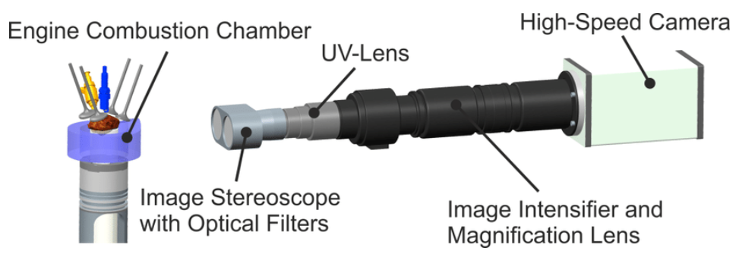
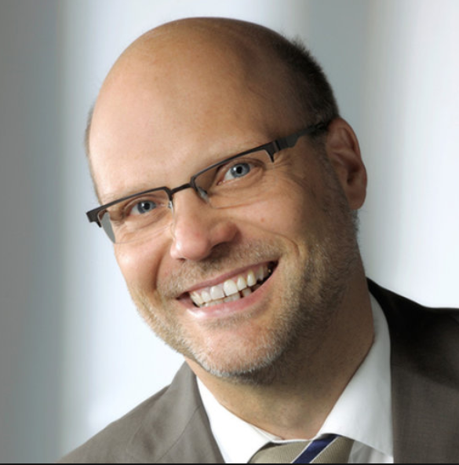
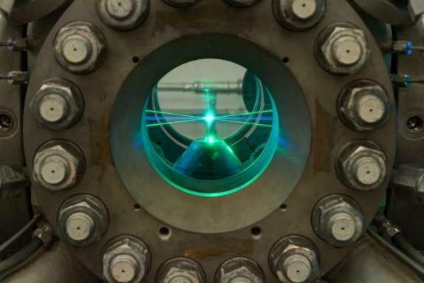
The lab of Prof. Wensing at the LTT department

Slide 24
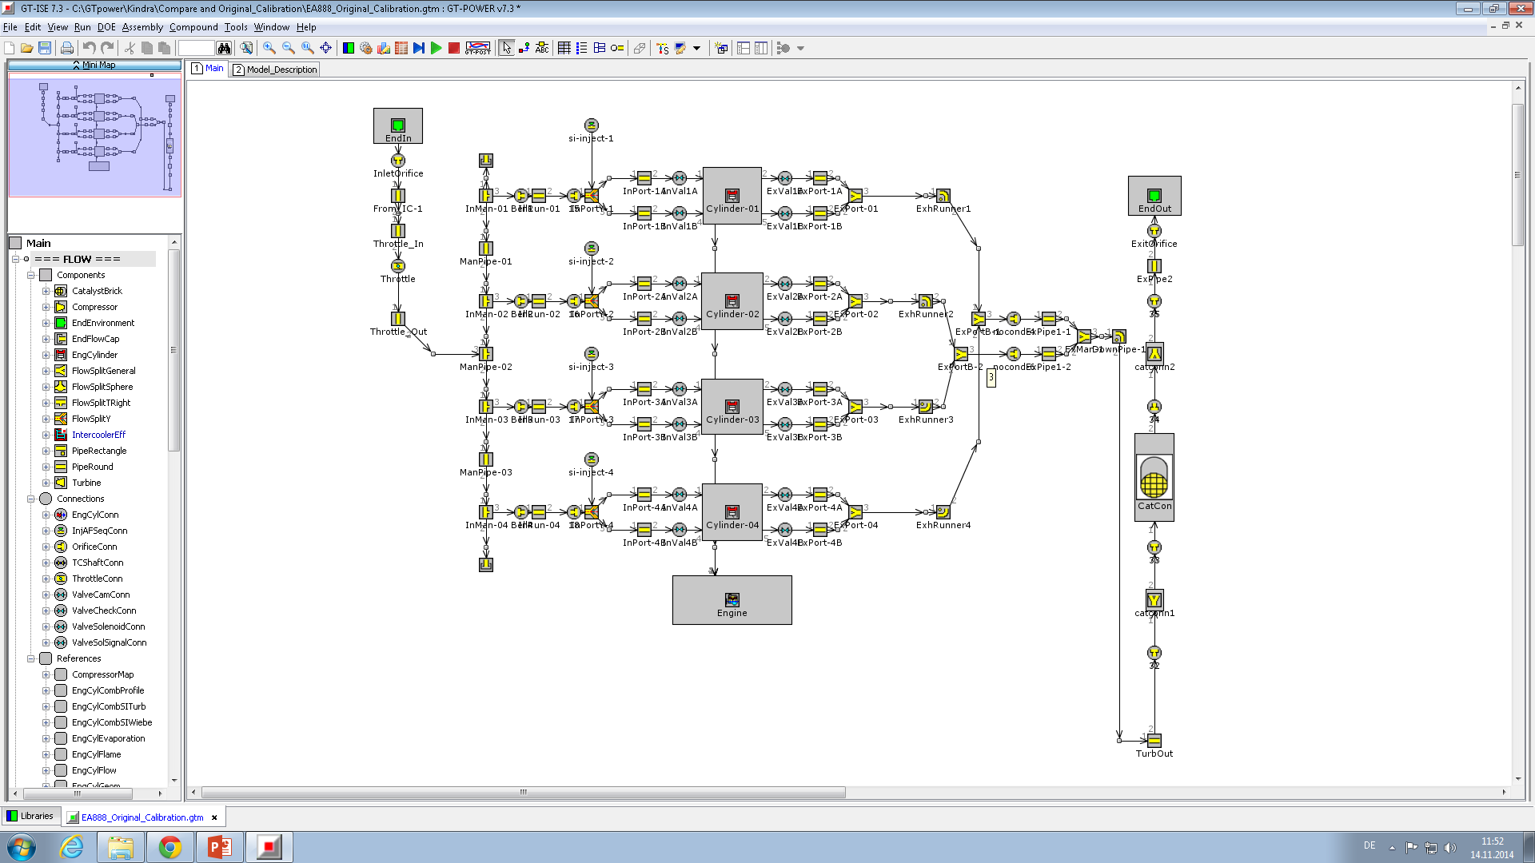
Engine simulation model (GT-Power)

Slide 25
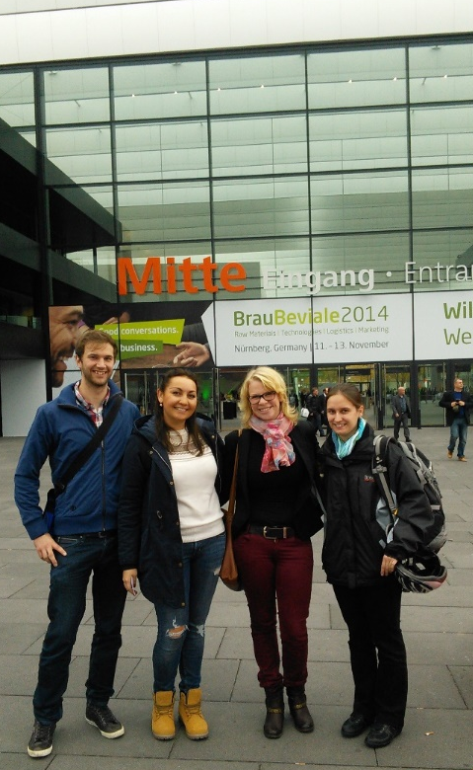
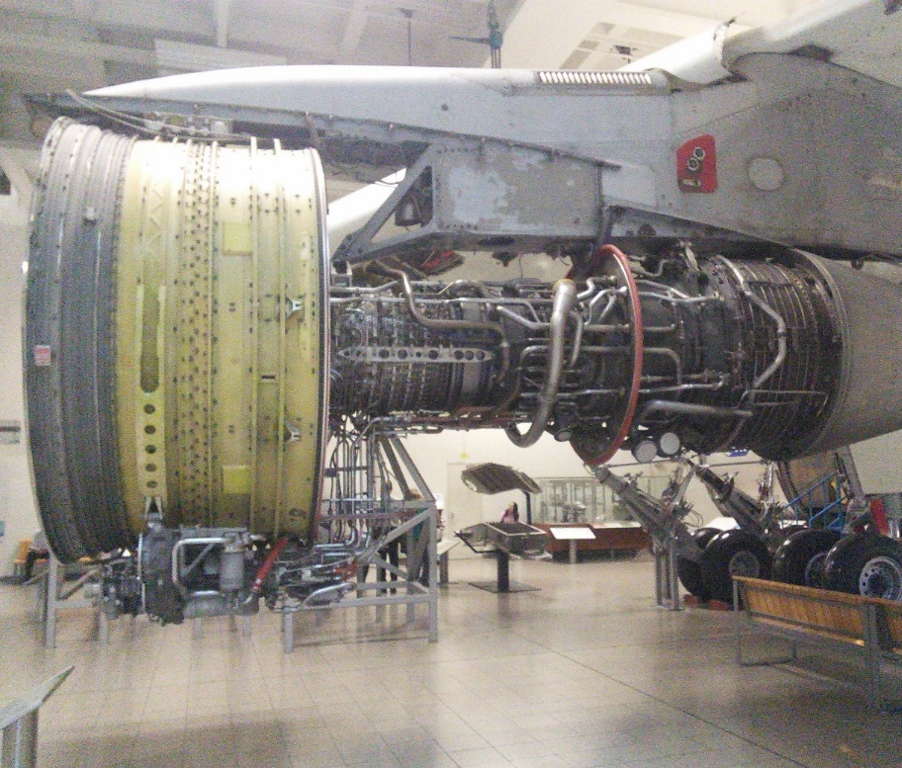
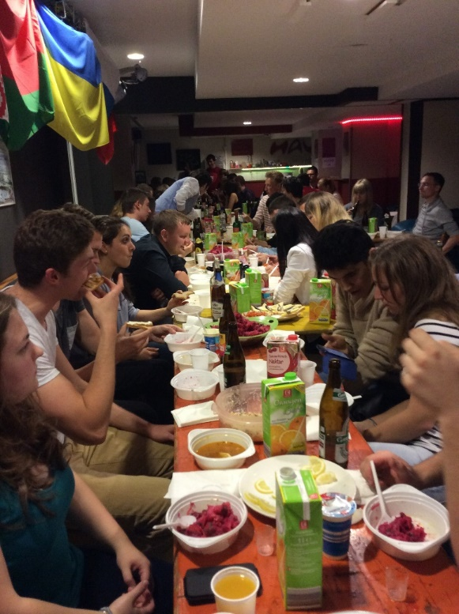
A lot of scientific and cultural activities
Conference in Nuremberg
The Deutsches Museum (Munich)
International dinner party

Slide 26
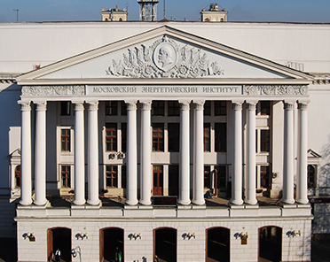
Research work at the MPEI (NRU). The department of innovation management
Research directions:
Thermodynamic optimization;
Heat transfer enhancement methods;
Turbomachinery flow path design;
GT cooling systems development.

Slide 27
The two-tier low-pressure steam turbine
Flowpath design
The last blade of the LPT
CNC milling machine tool

Slide 28
Advanced gas turbine cooling systems
Cad model of the leading edge cooling channel
Experimental model for the investigation with thermographic camera
Image of the cooled leading edge obtained by thermographic camera
Experimental model for the investigation with thermal liquid thermostat

Slide 29
Opportunities for cooperation between MPEI, FAU and industrial companies
Funding source for Russian side*
Federal target program
Russian Foundation for Basic Research
Russian Science Foundation
Applied research on the following fields of knowledge:
new and renewable energy, energy efficiency.
Fundamental research on the following fields of knowledge:
- engineering.
Fundamental research on the following fields of knowledge:
- engineering.
* - the German side receives funding for an international project on similar terms from the national funds

Slide 30
Thank you very much!

Slide 31
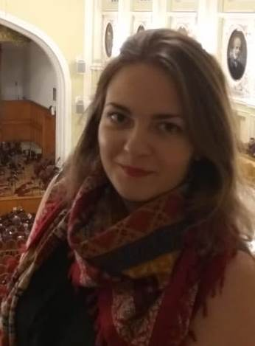
Anastasia Shimanskaya

Slide 32
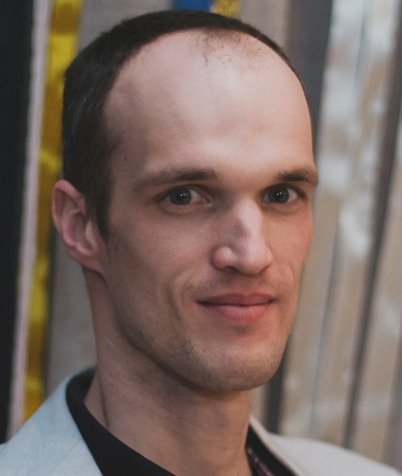
Ivan Kruzilov

Slide 33
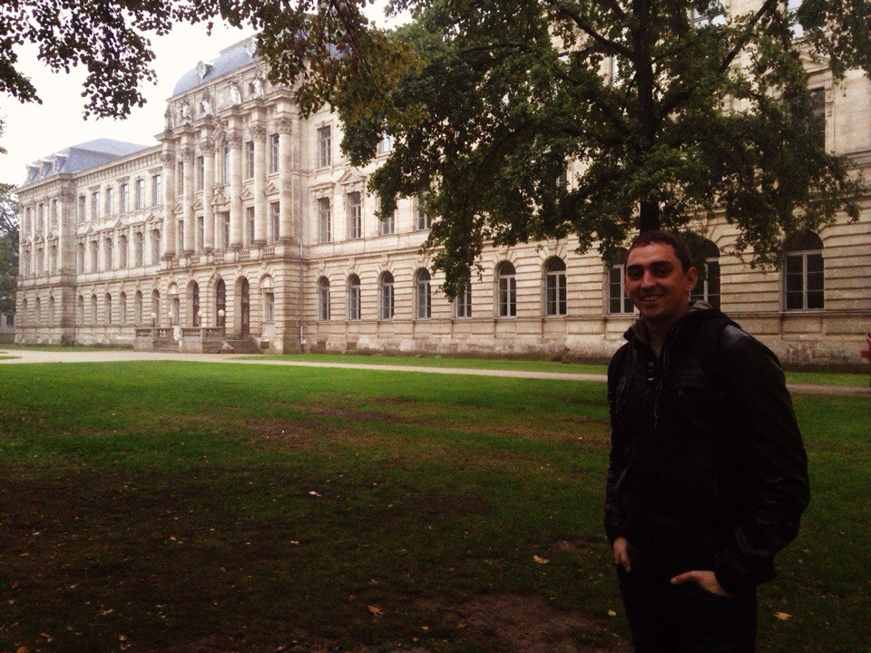
Dmitry Denischuk

Slide 34
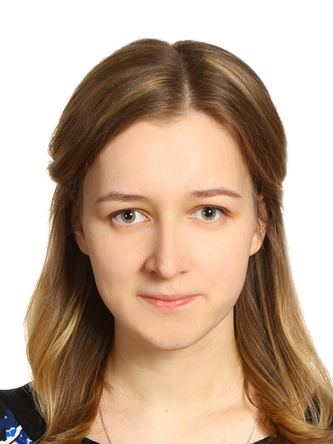
Nadezhda Fomenko (Gavrilova)

Slide 35
Numerical simulation of boiler’s burner
in the project design
for the boiler TGMP-314
using ANSYS
Student: Nadezhda Fomenko
Supervisors: TPP MPEI
Dr.-Ing. Vadim Prokhorov
LSTM FAU
Prof. Dr.-Ing. Antonio Delgado
Dipl.-Ing. Riadh Omri
Dipl.-Ing. Vojislav Jovicic
01.06.2018.

Slide 36
Goal and motivation
Goal
Numerical simulation part of the project design burner to get velocity, temperature and concentrations fields of substances at the inlet to the boiler furnace with using the data of the five operating modes of the burner
Motivation
To make numerical simulation of the boiler furnace with more precise input data
To get more experience in the ANSYS software
To learn how to work with structure mesh
To learn how to work with complex geometry and with big amount of meshes for one geometry

Slide 37
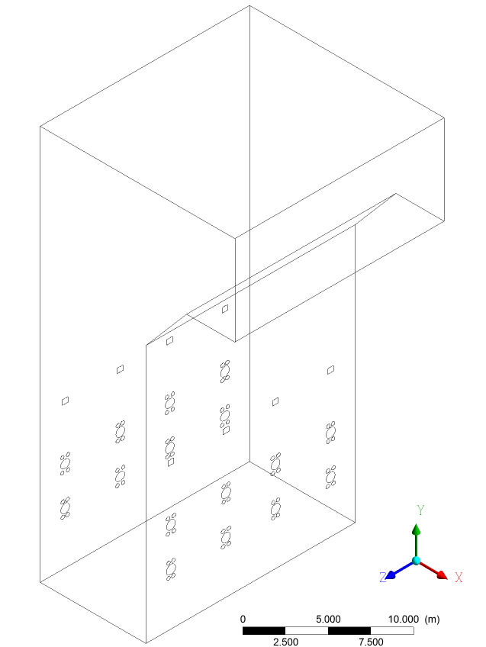
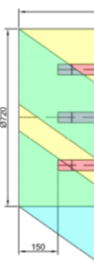
The main idea:
another way to numerical simulation of the furnace
“Traditional way”
Front of boiler
The problem:
The loss of information about
the mixing of gas and air
at the site of the burner before
front of the boiler
As usual:
Flow inlets into the boiler
are as planes with
the direction of flow

Slide 38
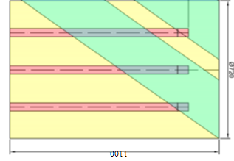
The main idea:
another way to numerical simulation of the furnace
“New way” of furnace simulation
Goal of my work
Numerical simulation
of the burner:
the fuel + primary air
2. Copying information about the flow of the fuel+primary air as the profile to the model of the boiler
Front of boiler

Slide 39

Geometry of burner
Front of boiler
primary air
Creating geometry only for V-section
because the geometry has a symmetry
fuel tubes

Slide 40
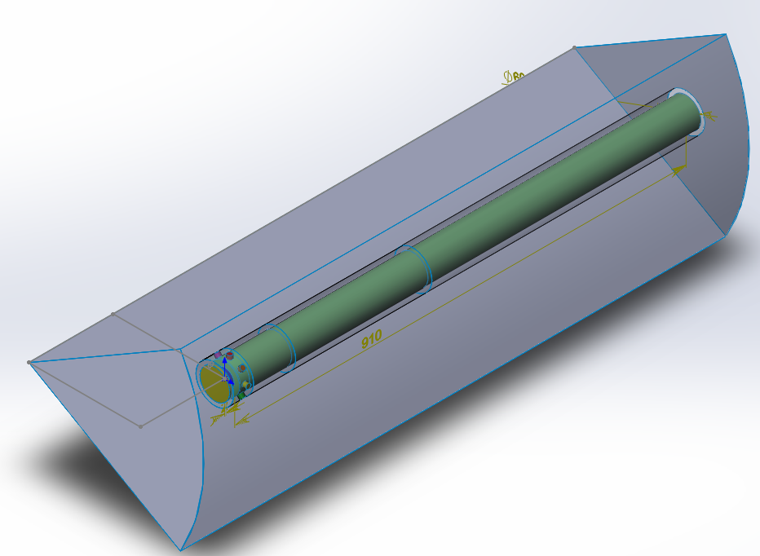
V-section of burner
Inlet of primary air
Inlet of fuel
Plane of inlet into boiler
my goal is to get
the numerical values
of the flow parameters
on this plane
Fuel tube
Primary air section

Slide 41
Steps of work
Finding the optimal division of geometry to create mesh
Finding the optimal method for connection meshes
Finding the optimal method of choosing boundary conditions
Investigation of the feasibility of reducing the number of mesh
elements by cutting off part of the geometry
5. Numerical simulation of the five operating modes of the burner

Slide 42
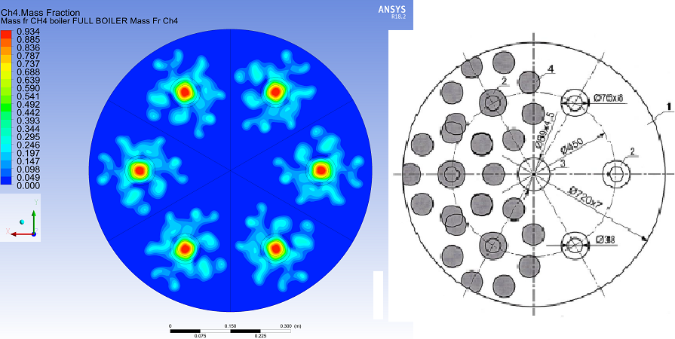
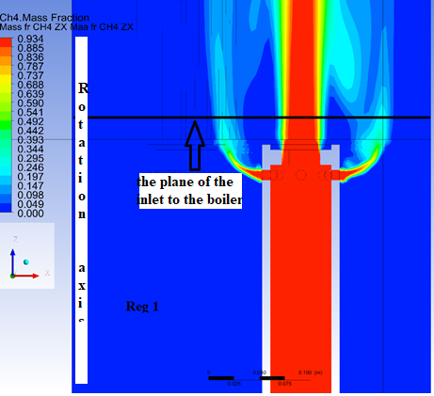
Results of numerical simulation of the five operating modes
comparison of the distribution
of methane at the inlet to the boiler with
the theoretical calculations
the partial combustion gas before
the inlet to the boiler

Slide 43
Summary of work
The goal of the work was achieved.
The results can be used for further work with the boiler.
The numerical values of all parameters at the boiler inlet are obtained.
New skills were acquired in the ANSYS software during the process of work.
All the work done in Germany became the basis of my master's theses.
This will allow me to solve more complex cases in the future.

Slide 44
Words of thanks…
Prof. Riedle – for the great chance to participate in this internship
Dipl.-Ing. Vojislav Jovicic – for help in solving all life issues in Germany and supervision
Dipl.-Ing. Riadh Omri – for advices about work in ANSYS
Dr. Orlov – for organization and information about internship
Dr.-Ing. Vadim Prokhorov – for support of ideas in my scientific work

Slide 45
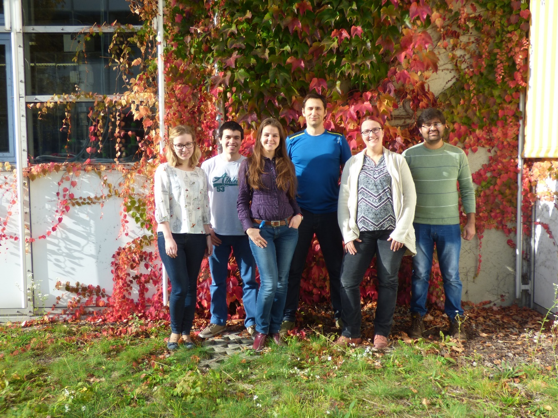
Thank
you
for
your
attention!

Slide 46
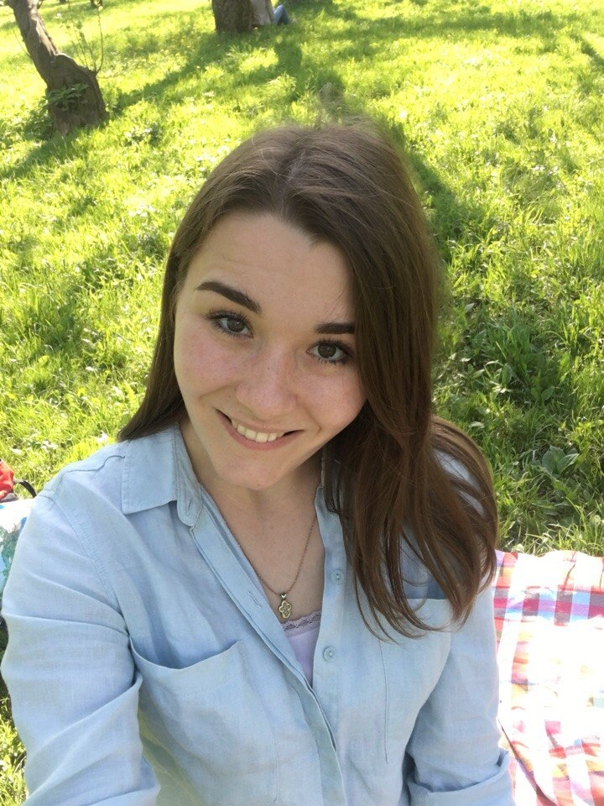
Tatyana Zyeva

Slide 47
Investigation and calculation of spray propagation under cross-flow conditions
Student: Tatiana Zueva
Supervisor from MPEI: D.Eng.Sc. Garyaev А.B.
Supervisor from FAU: Dipl.Ing. Richard Welß
01.06.2018

Slide 48
Motivation
Comparison between theoretical and experimental approach to scientific investigations
Getting more experience in experimental investigation
Studying of the opportunities of creating mathematical models of physical processes in MatLab
Studying of new methods of optical measurements
01.06.2018

Slide 49
The main goal
Creation of the theoretical models for the description of the wind blown gasoline sprays in a flow channel.
Why is it important? Where can it be used?
Theoretical model can be used for any wind blown gasoline sprays while experimenal datas can be used only for certain limited conditions (which were used in the experiment).
Model should be valid for 50 – 400 bar injection pressure and 5 – 50 m/s crossflow velocities
01.06.2018

Slide 50
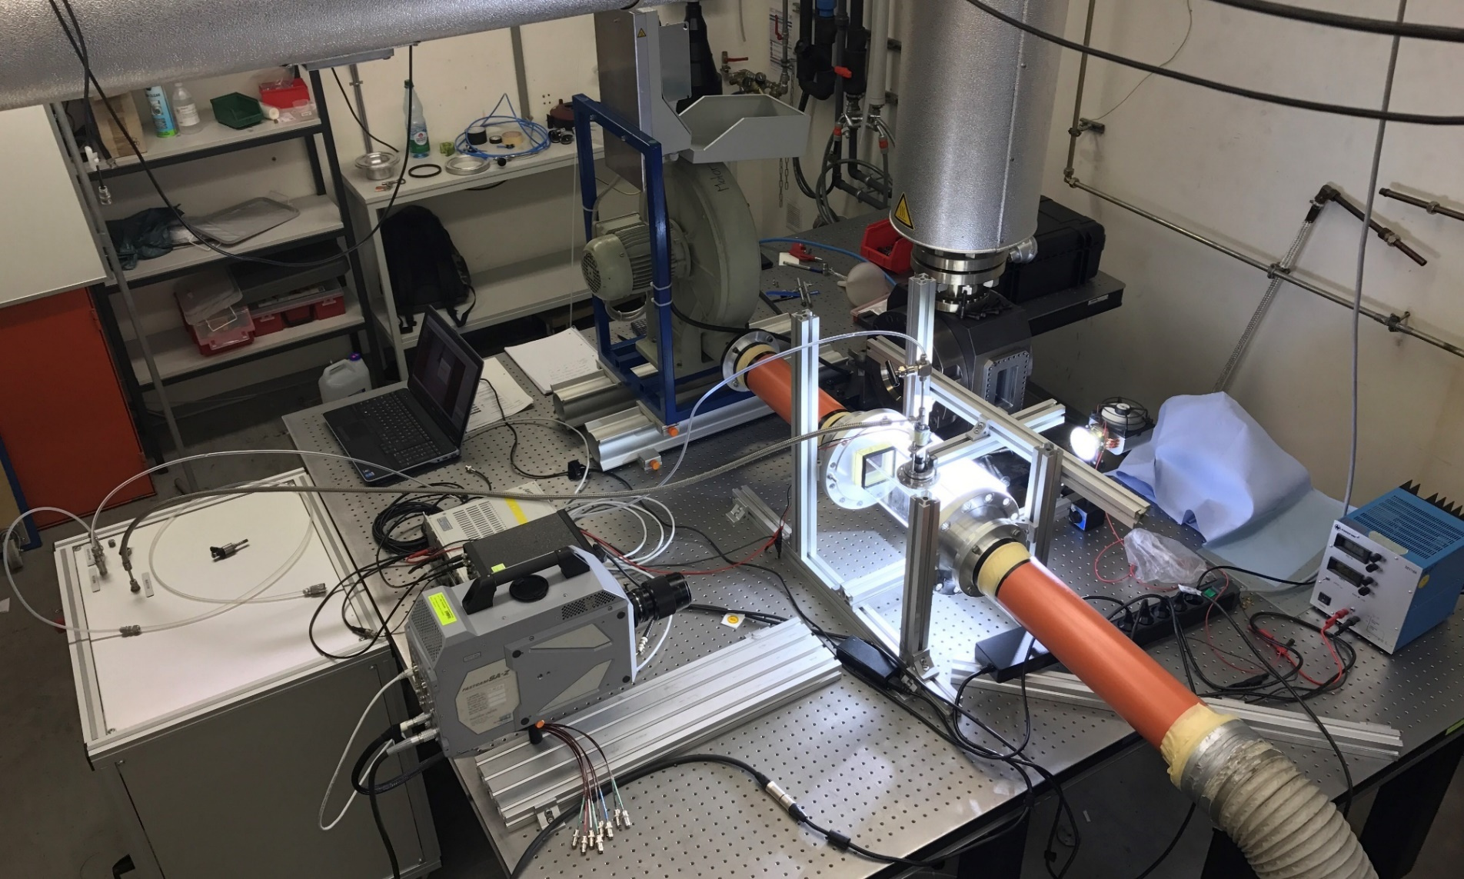
Shadowgraphy at flow channel:
Experimental setup
Fig. 1 Photo of the experimental setup
01.06.2018

Slide 51
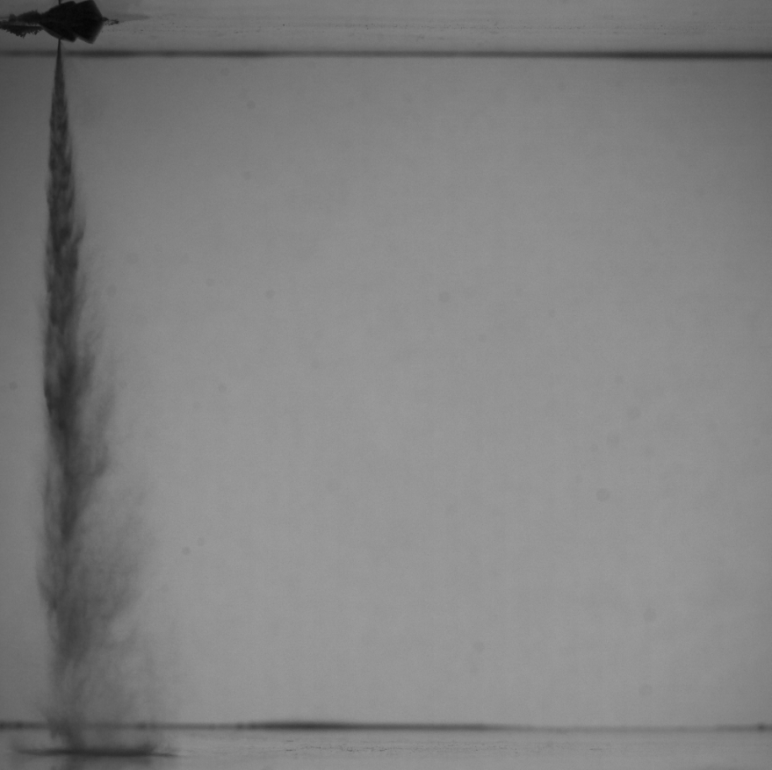
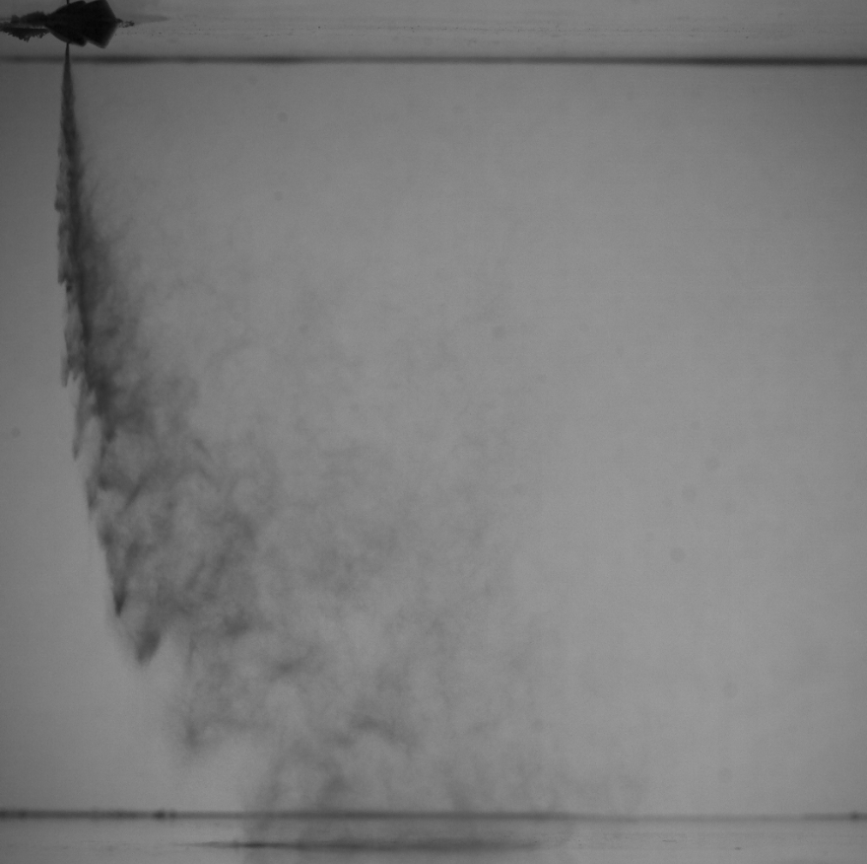
Results of the experiment
Fig. 2 – Photo of spray. Pressure is 150 bar and cross-flow velocity is 5 м/с
Fig. 3 – Photo of spray. Pressure is 150 bar and cross-flow velocity is 5 м/с
01.06.2018

Slide 52
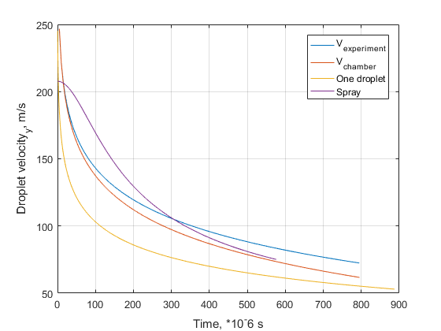
Comparison between experiments and models
Fig. 4 Vertical velocity according to the experiments and theoretical models
Blue and red curves – experiment;
Yellow curve – results of model for one droplet;
Purple curve – results of model for spray.
01.06.2018

Slide 53
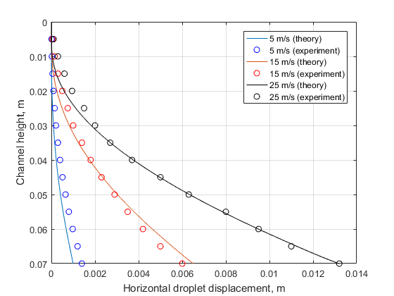
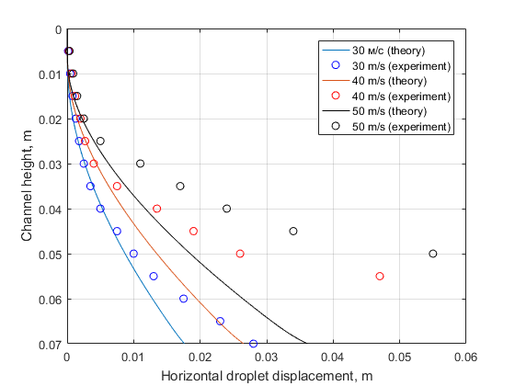
Comparison between experiments and models
Results of the model for one droplet:
$P_{injection}=150$bar
One hole injector
$$d_{droplet}=10 μm$$
Fig. 5 – Horizontal displacement of the one droplet according to the theoretical model and experiment for small velocities
01.06.2018

Slide 54
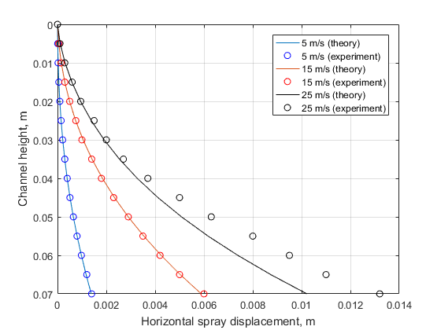
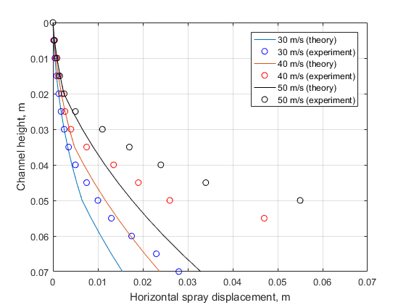
Comparison between experiments and models
Results of the model for spray:
$P_{injection}=150$bar
One hole injector
$$d_{droplet}=10 μm$$
Fig.6 - dependences of the horizontal displacement of the spray along the channel height at an injection pressure of 150 bar and different velocities of the cross-flow
01.06.2018

Slide 55
Conclusion and words of thanks
New knowledge was recieved in:
Making experiments
Working in MatLab
Creation theoretical models
Learning new optical methods of measurements
Results of the scientific work during the internship are the basis of my master thesis and will be improved in frame of it.
Thanks a lot to:
Prof. Riedle for very important and useful contribution to our future
Dipl. Ing. Richard Welß for scientific consultations and support during the work at LTT
Mr. K. Orlov for solving of organization problems
01.06.2018

Slide 56
Thank you for your attention
01.06.2018

Slide 57
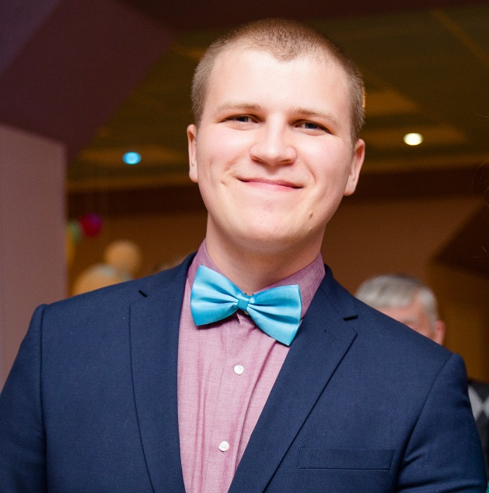
Evgenii Striukov

Slide 58
Evgenii Striukov

Slide 59
PS (Power Generation Services Division)
  Operation and maintenance
  24/7 support
  Repairs and replacements
  Modernizations and updates
  Spare parts management
  Trainings
  Digitalization and digital solutions
  etc.

Slide 60
Big data

Slide 61
Data
  Data collection
  Data transfer
Monitoring
  Conditions monitoring
Solutions
  Finding out problems
  Solutions preparing
Solutions
  Finding out problems
  Solutions prepating
Action
  Solutions implementation
  Long term programs

Slide 62
Condenser Assessment
ps
T2
  T1 is CW inlet temperature
  T2 is CW outlet temperature
  ps is condenser pressure
  Tc is condensate temperature
T1
Tc

Slide 63
Condenser assessment (idea)
Real heat transfer coefficient:
Q=C·(T₂-T₁)
Q=k_{real}·A·ΔT
k_{real}=$\frac{\text{C}\text{·(}\text{T}\text{2}\text{−}\text{T}\text{1}\text{) }}{\text{A}\text{·}\text{ΔT}}$
Theoretical heat transfer coefficient :
k_{theor} = k₀ ·$\sqrt{\text{v}}$·C_{Cl}·C_{M}·C_{T}
Condenser performance:
CP=$\frac{\text{k}\text{real}}{\text{k}\text{theor}}$

Slide 64
Power plant condensers performances
%

Slide 65
Condenser pressure
mbar

Slide 66
Estimated power loss for unit 10
1 mbar loss → 0.15 MW loss
Δp ≈ 10 mbars
Baseload time ≈ 400 hours
0.15$\text{·}\text{10}\text{·}$400 = 600 MWhours

Slide 67
Acknowledgements
Klaus Riedle
Konstantin Orlov
Markus Zenker
PS PG team in Mülheim

Slide 68
List of Applicants 2018
Domanov, Evgenii ТФ-02м-17
Romanov, Vladimir TF-12M-17
Romanov, Vladislav TF-12M-17
Dugur, Irina FP-08m-17

