Slide 1

International Summer School
National Research University “Moscow Power Engineering Institute”
On Power Engineering

Slide 2
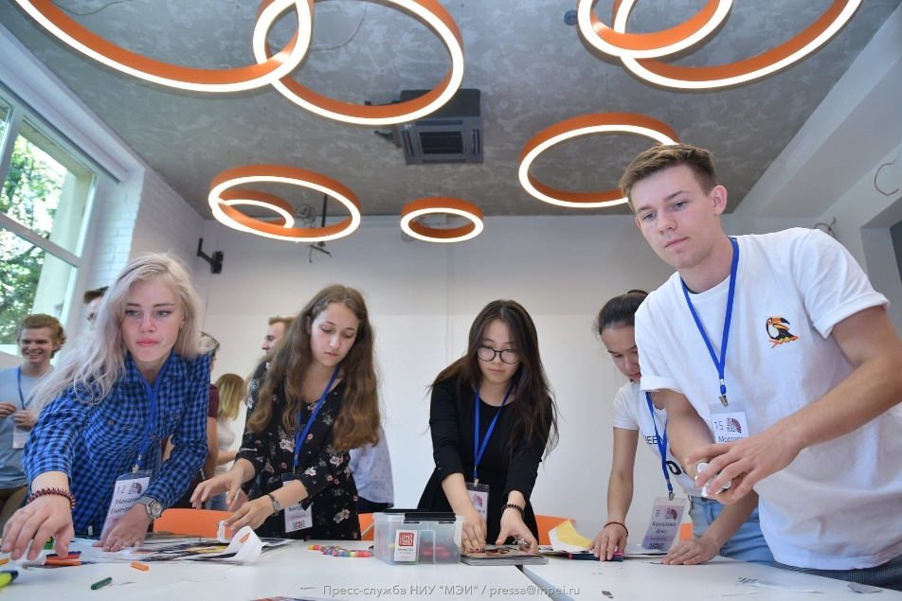
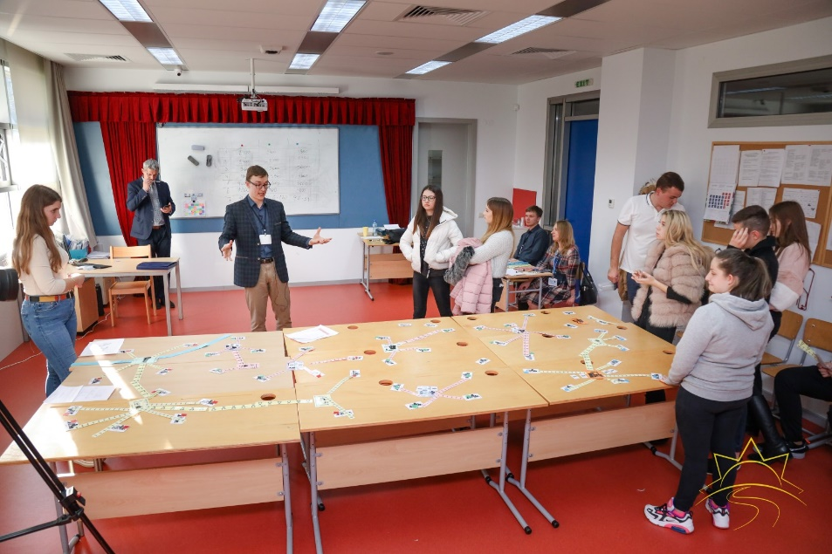
Engineering Games
Original engineering games developed in Institute of Electrical Power Engineering

Slide 3
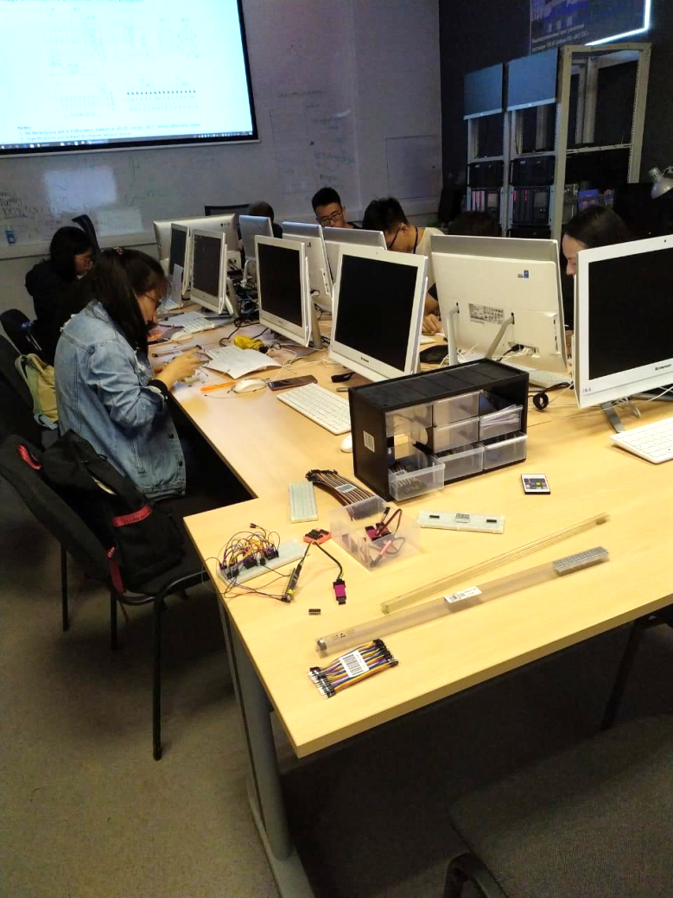
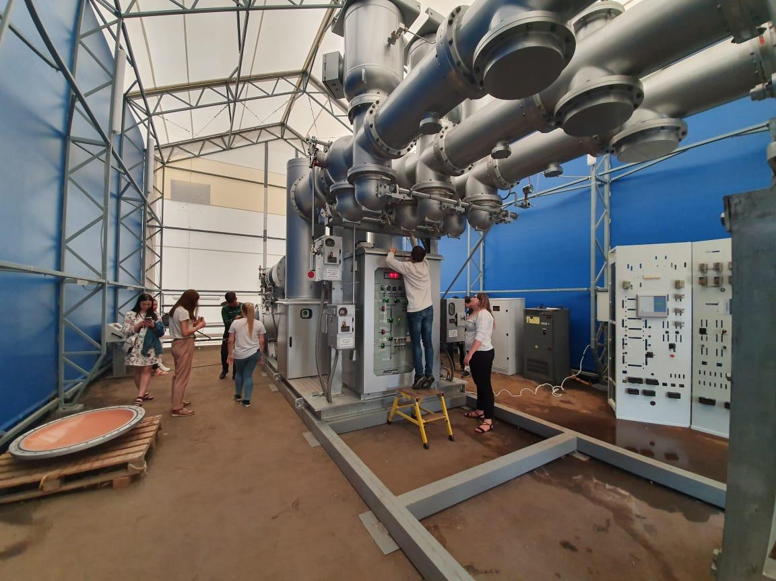
Labs and workshops
Labs and workshops on power equipment and industrial software

Slide 4
Labs and workshops
Power quality studies on physical model
Integration of distributed generation units in power network
Relay protection modelling in PSCAD
Assembling of relay protection devices on microcontrollers
High voltage test of insulators
Operation of a gas-insulated high-voltage switchgear unit
Measurement of a circuit-breaker cut-out speed

Slide 5
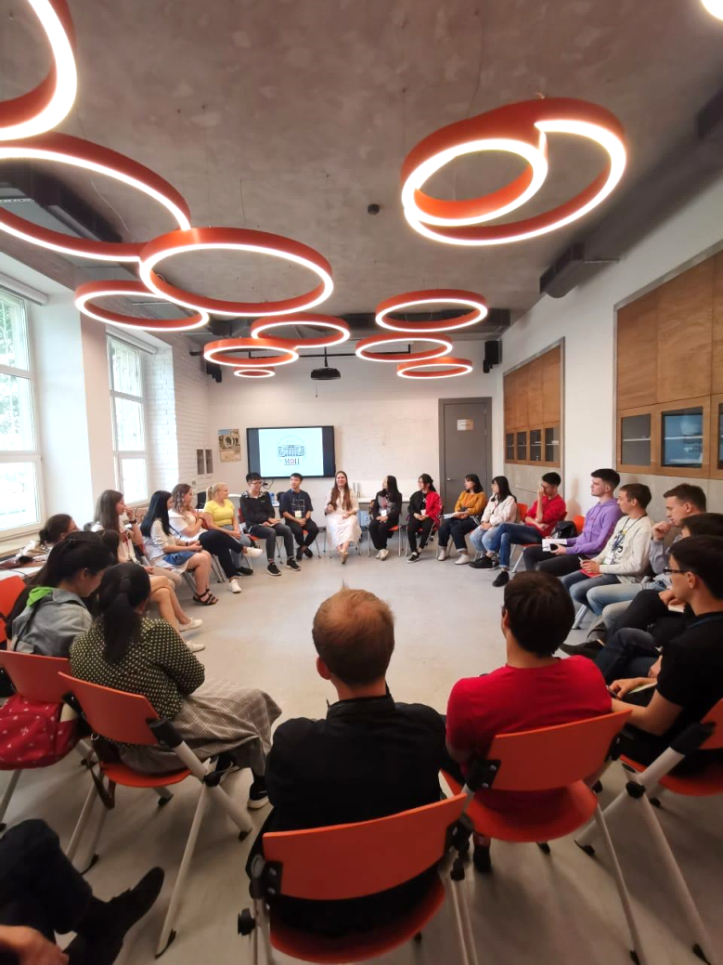
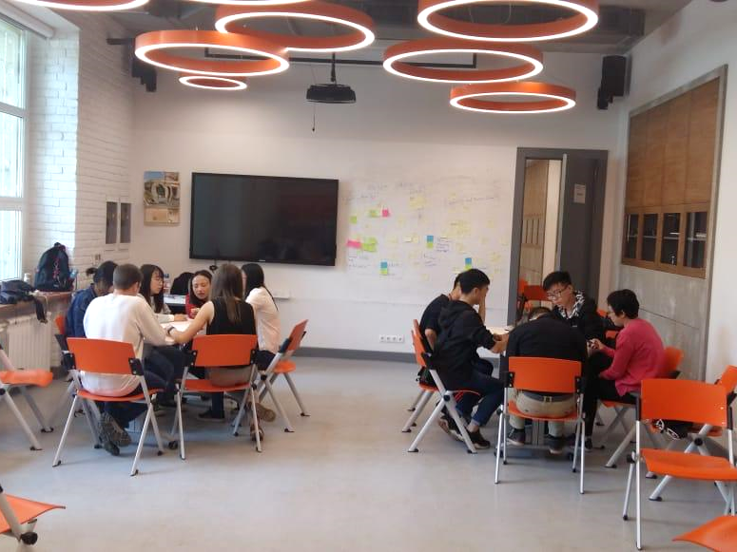
Research projects
Team project sessions during the School and project presentation at the end

Slide 6
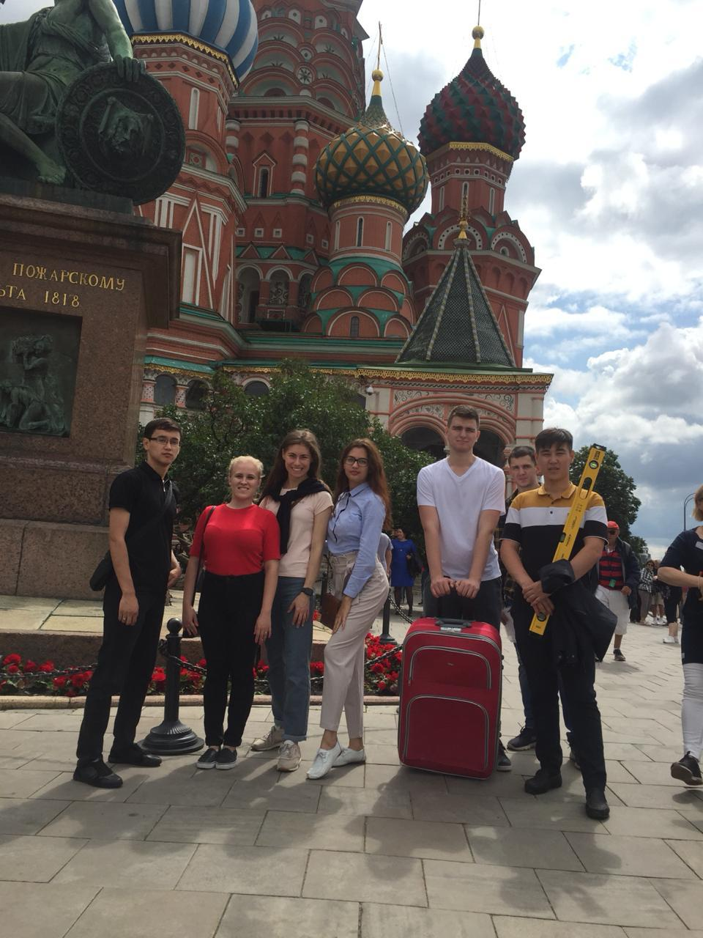
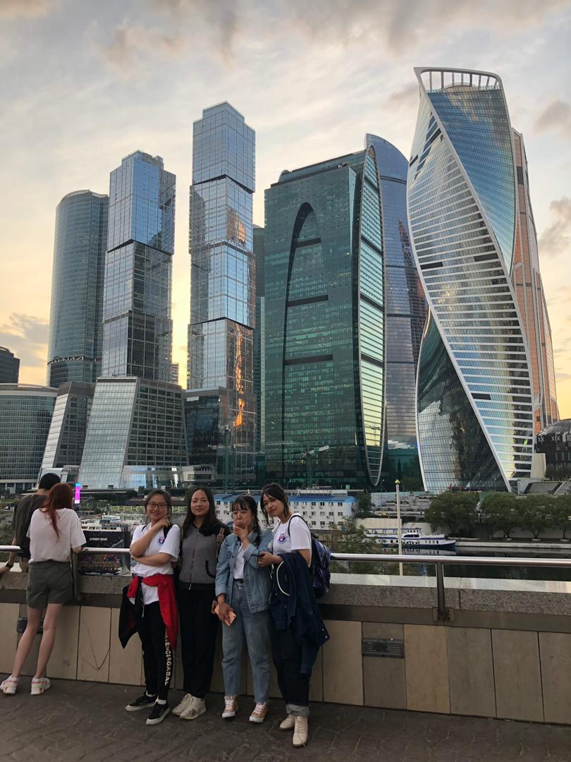
City quest
Moscow city quest guided by volunteers

Slide 7
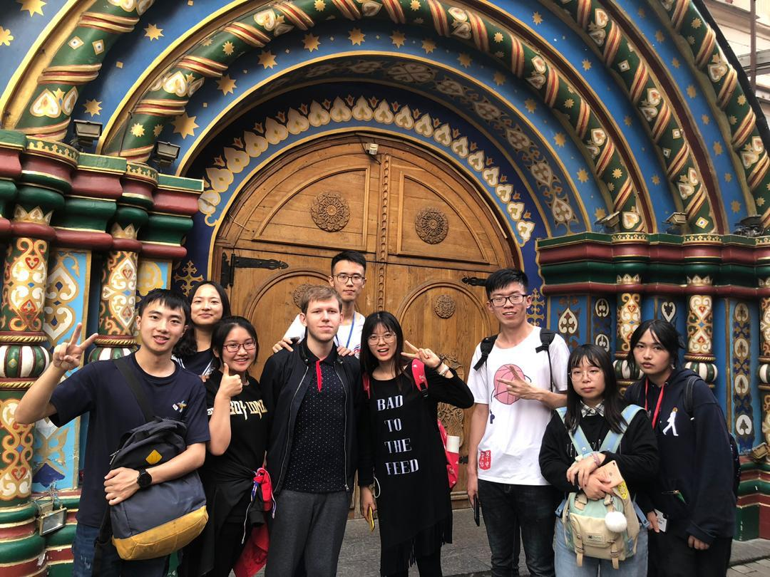
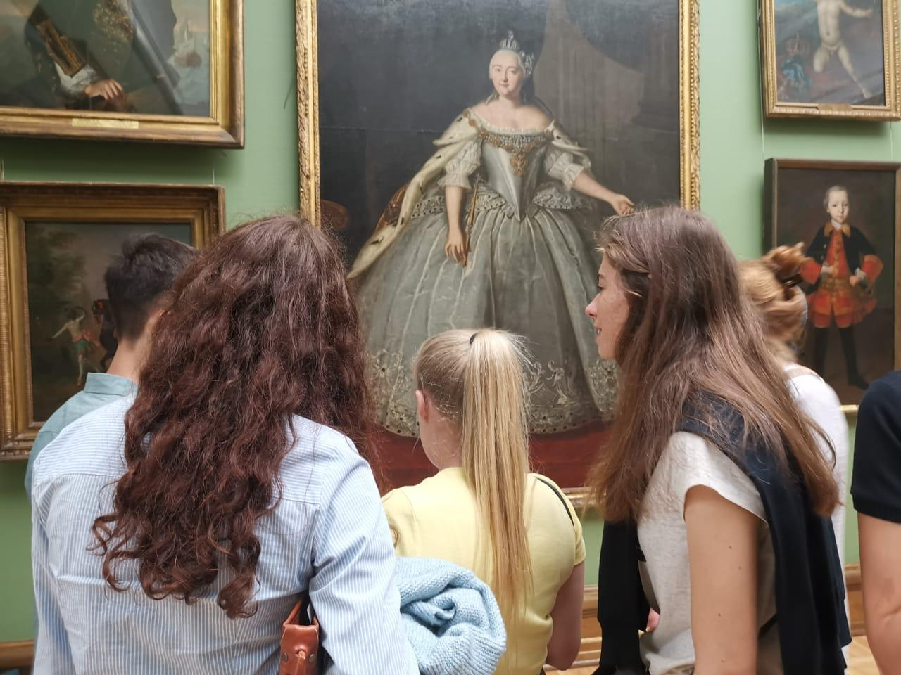
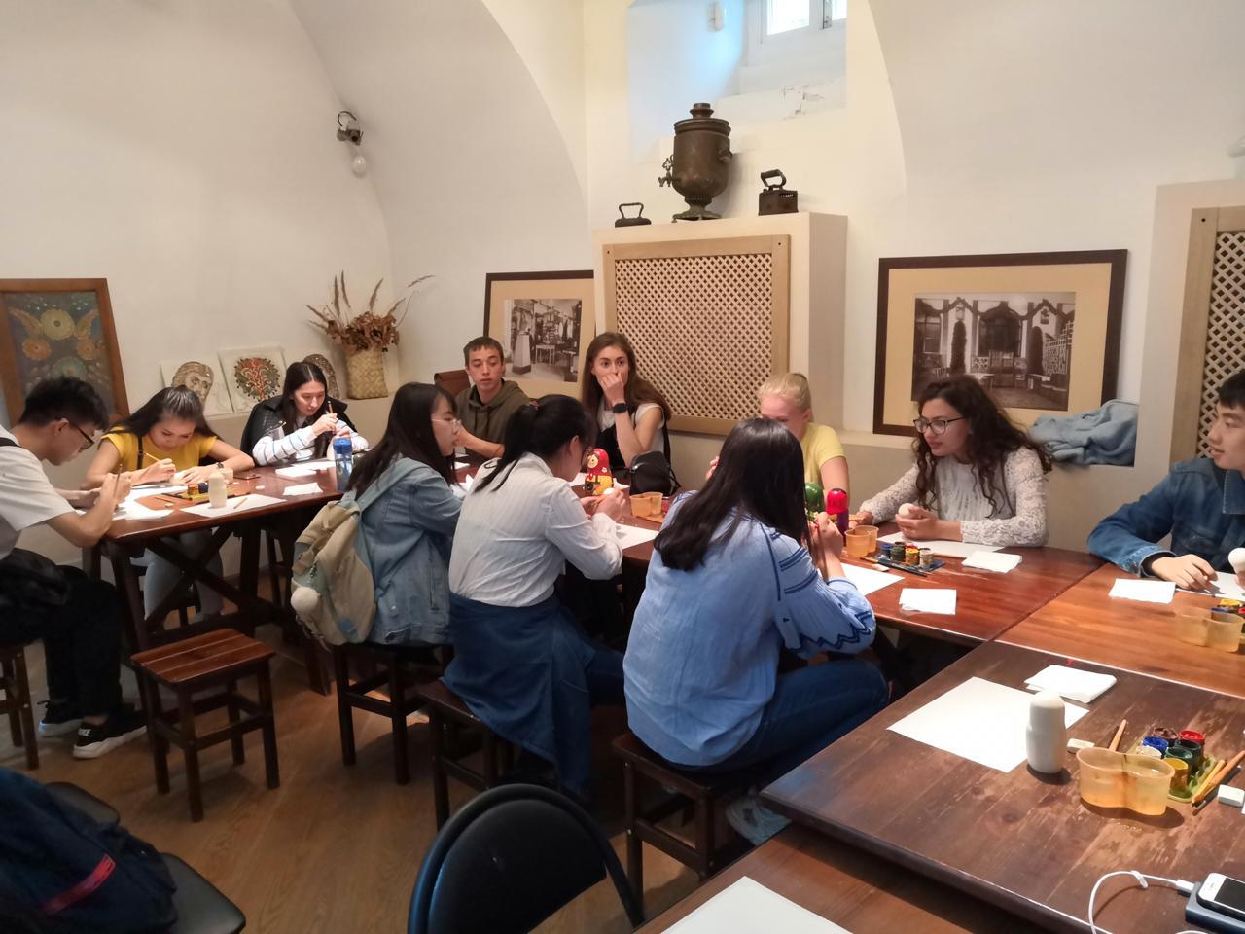
Culture
Visiting museums and traditional craft workshops

